Slide 1
Purview Quick Start blueprint
Blueprint

Slide 2




Lightweight guide to mitigate data leakage Protect confidential data across M365 estate
Good
Better
Best
Create sensitivity and sub labels: Define and publish a ‘Confidential/AllEmployees' label for files and SharePoint sites
Set default label: Automatically apply ‘Confidential\AllEmployees’ label to new files created in M365
Apply basic DLP policy: Block sharing of labeled content via SharePoint, OneDrive and Exchange
Enable Audit logging: Track user and admin activity across M365
Create custom SITs: Detect and classify data unique to your organization, like internal project codes, intellectual property
Configure client-side auto-labeling: Use custom-built SITs and auto-apply labels in Office apps as users create or edit content
Enable Teams and Endpoint DLP: Create policies to block sensitive files from USB copy, printing, sharing externally, etc.
Apply email protection: Use DLP to block emails with custom-built SITs and auto-label the email to inherit highest sensitivity from any attached or linked files
Encrypt files: Apply encryption to content labeled with high-sensitivity sub-labels or containing critical SITs
Extend service-side auto-labeling: Auto-label existing files and emails in transit across SharePoint, OneDrive, Exchange
Run Insider Risk Mgmt Analytics: Identify top risks and receive recommendations on pre-built policies to configure
Enable Adaptive Protection: Dynamically adjust DLP and Conditional Access policies based on user’s risky activity
Activities
Outcomes
Establish foundational data security with minimal configuration
Expand protection to endpoints and automate classification
Continuous improvement of data security practices
Effort*
1-2 weeks
2–4 weeks
1-2 weeks
*Suggested efforts should be reviewed into timelines based on your tenant size and organizational complexity

Slide 3
Good
Protect your sensitive information
Block sharing of sensitive information
Create sensitivity labels
Create sensitivity sub-labels
Order labels by priority
Publish sensitivity labels
Set as default label
Enable OneDrive and SharePoint labels
Enable Audit logging
Create and deploy DLP policies across:
Exchange
SharePoint
OneDrive

Slide 4
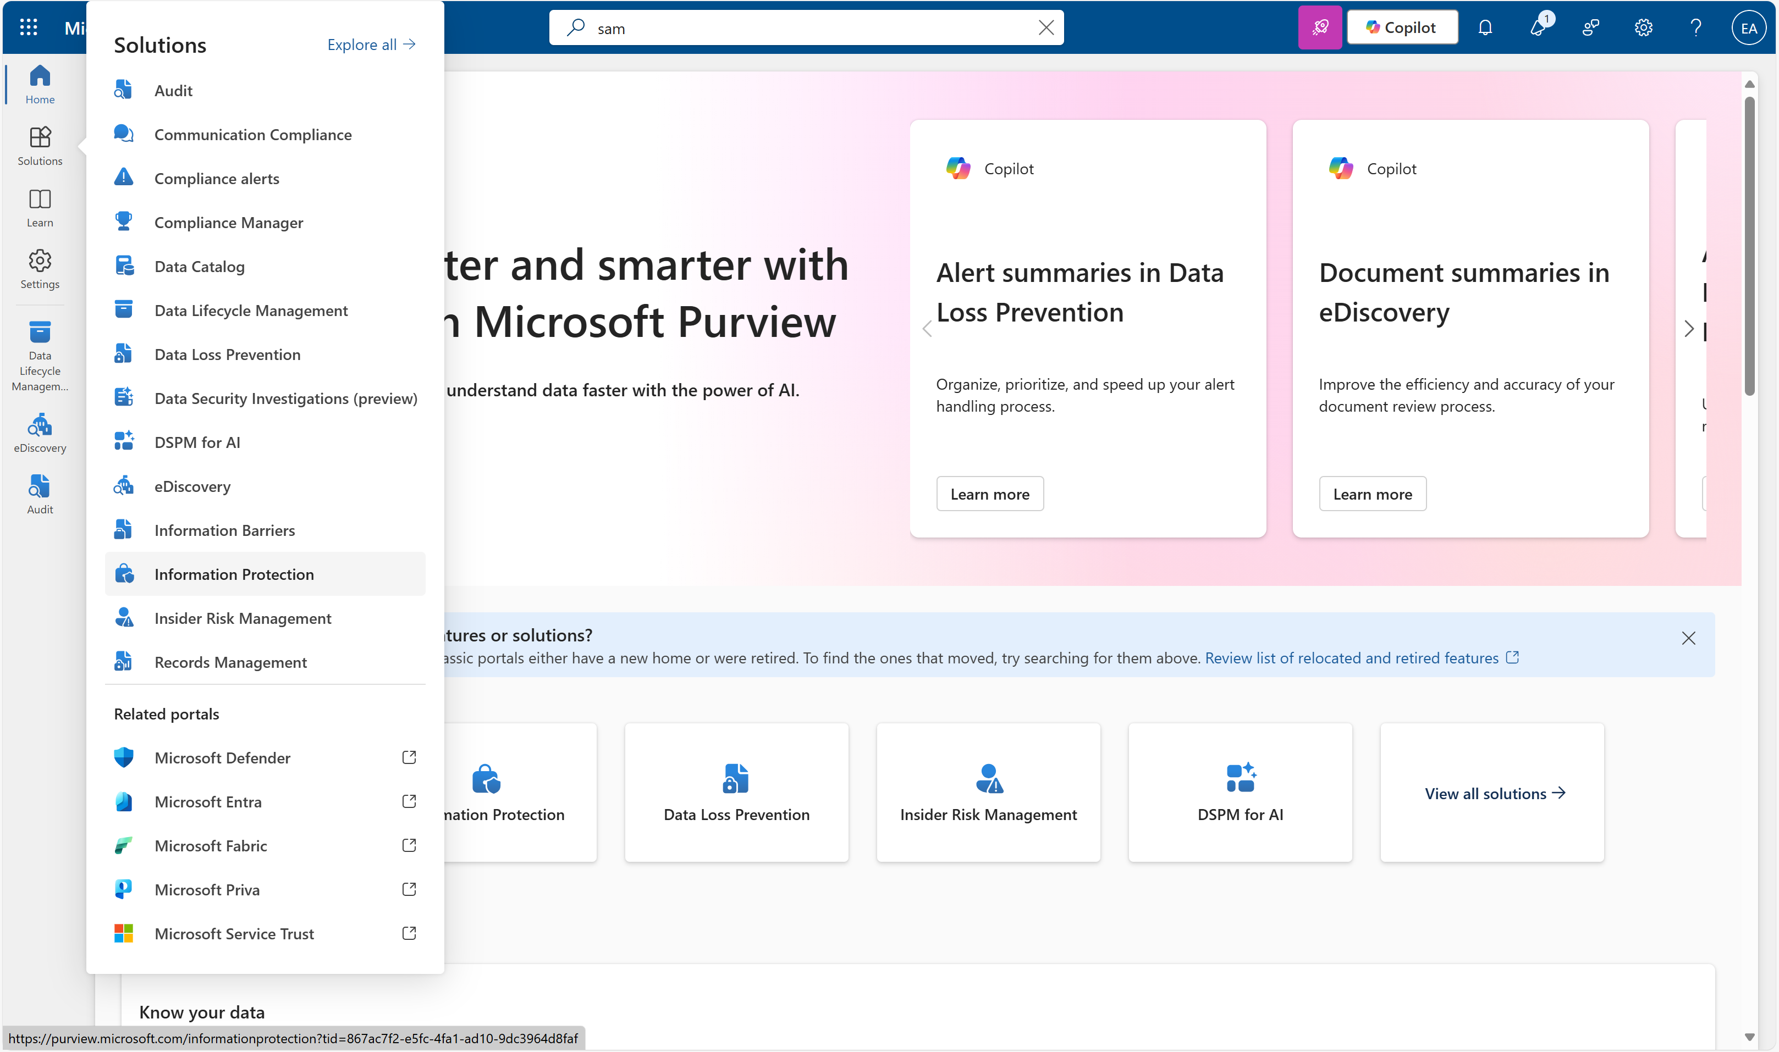
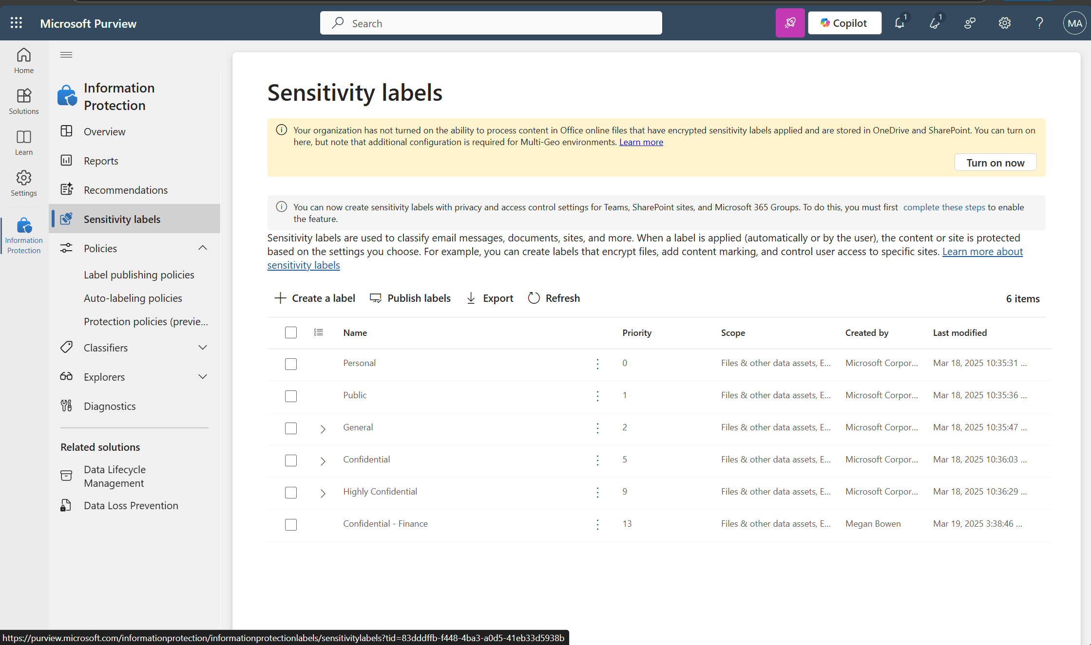
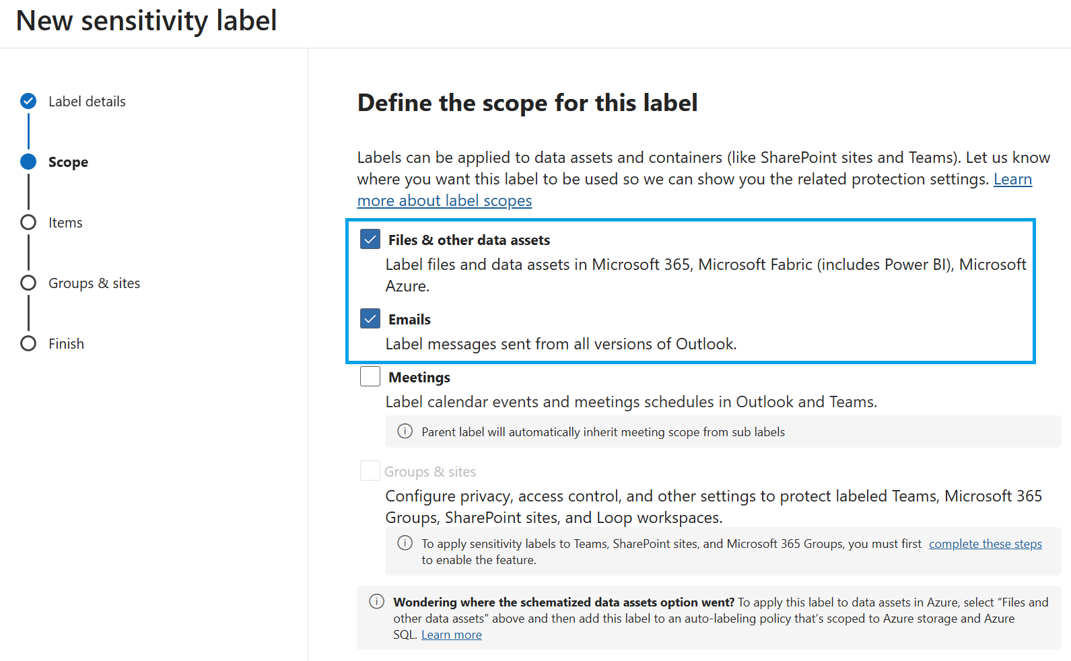
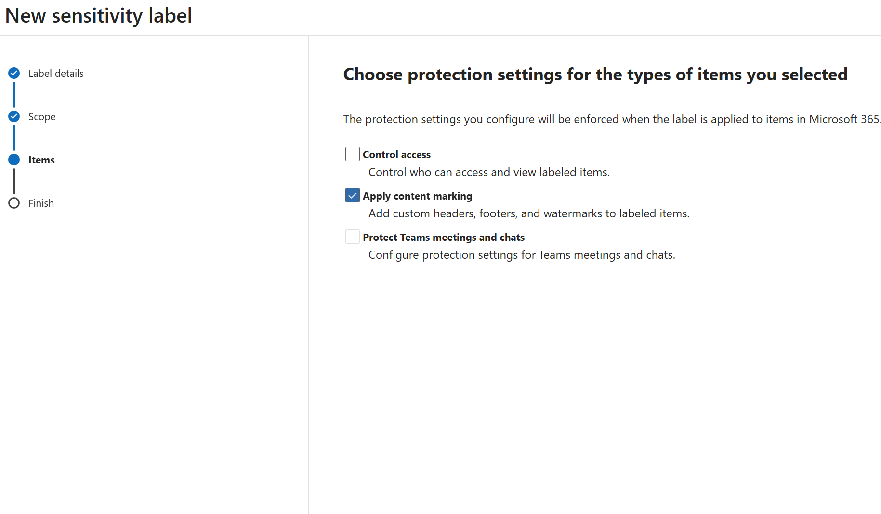
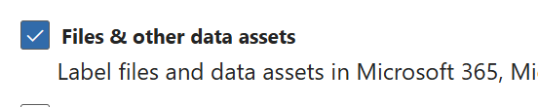
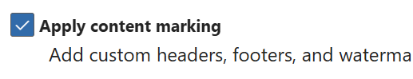
Protect your sensitive information
Create sensitivity labels
Sensitivity labels help classify and protect content across M365. You can define parent labels (e.g. Confidential) and sub-labels (e.g. AllEmployees) to restrict access, apply encryption and content marking.
1
2
3
Available with Business Premium or above
How to do it
Go to purview.microsoft.com
Go to Solutions > Information Protection
4
5
Select Sensitivity labels > + Create a label
Define:
Label 1 name: Confidential, General
Label 2 name: General
Scope: files and other data assets
Configure protection settings:
Add content marking
Learn more on our “Create and configure sensitivity labels and their policies” page

Slide 5
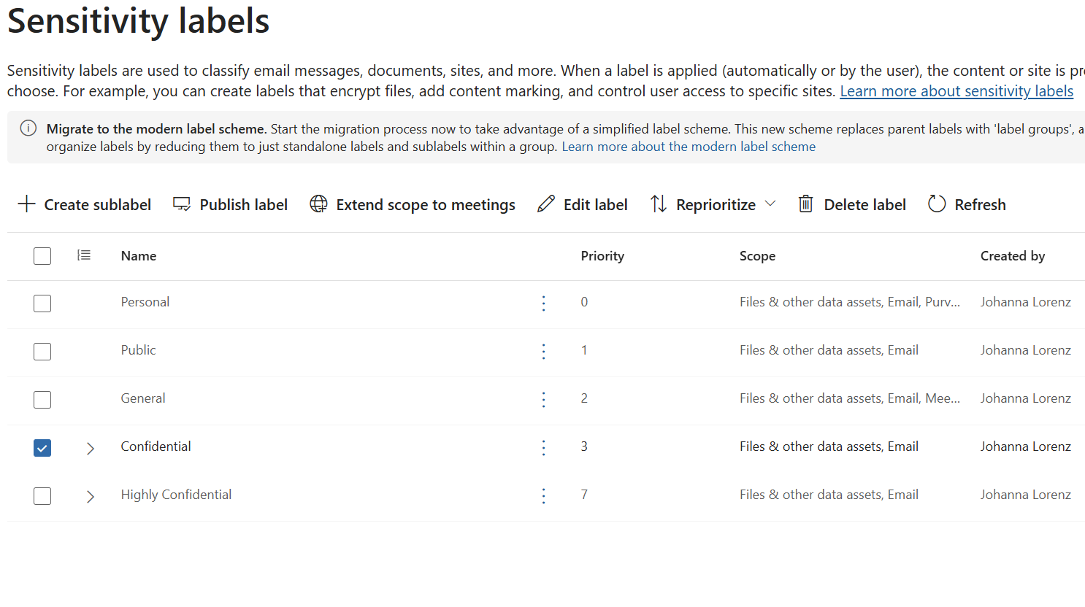
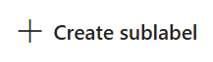
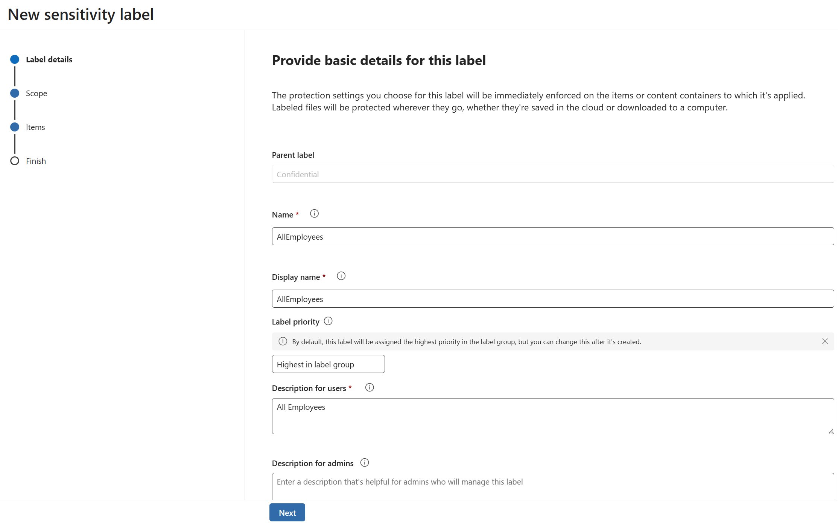
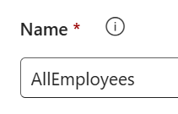
Protect your sensitive information
Create sensitivity sub-labels
Sub-labels allow you to apply more granular protection within a broader classification, tailored with access controls, encryption or usage restrictions. This helps balance security with productivity, ensuring the right level of protection for different types of sensitive data.
1
2
3
Available with Business Premium or above
How to do it
Go to purview.microsoft.com
Go to Solutions > Information protection
4
5
Select a Sensitivity label > +Create sub-label
Define:
Name: AllEmployees
Scope to: files and SharePoint sites
Configure protection settings:
Add content marking
Learn more on our “Create and configure sensitivity labels and their policies” page

Slide 6
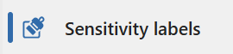
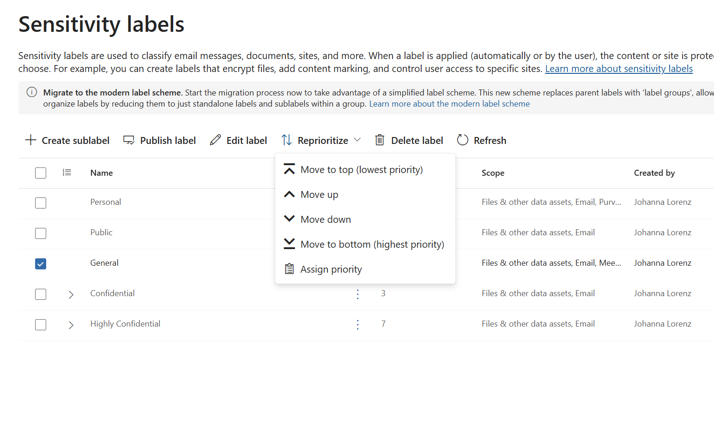
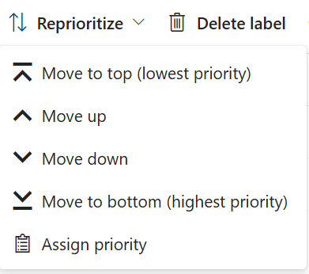
Protect your sensitive information
Order labels by priority
Label priority determines which sensitivity label is applied when multiple labels match the same content. The highest priority label wins – typically the one with the most restrictive protections. This ensures more sensitive labels override less sensitive ones.
1
2
3
Available with Business Premium or above
How to do it
Go to purview.microsoft.com
Go to Solutions > Information protection
4
Select Sensitivity labels > Look at Priority
Select a label and select Reprioritize
Move less sensitive or default labels down (closer to 0)
Move highly sensitive labels up numerically
Learn more on our “Create and configure sensitivity labels and their policies” page

Slide 7
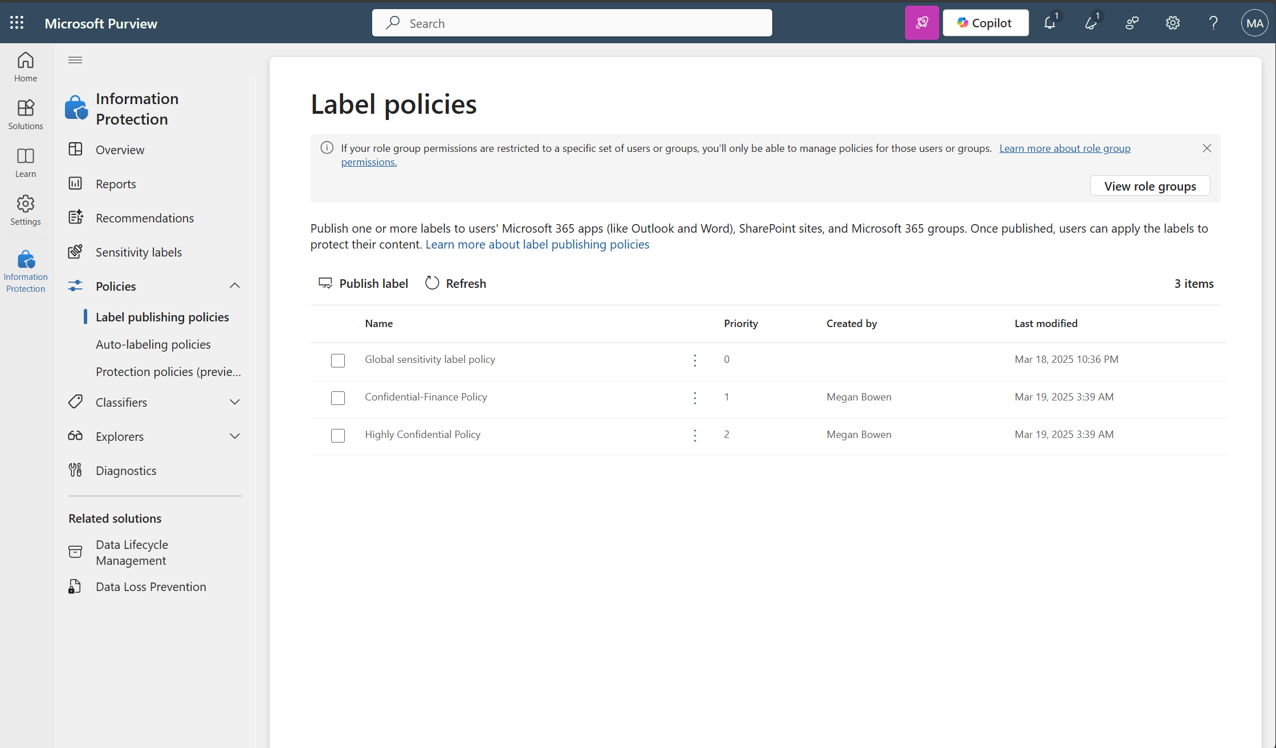
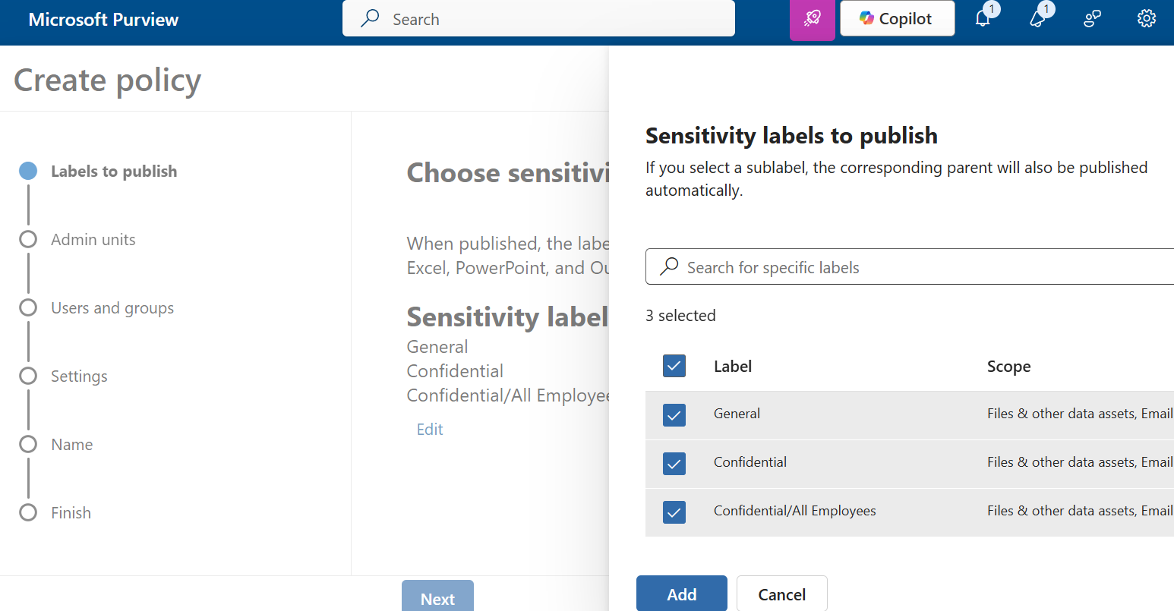
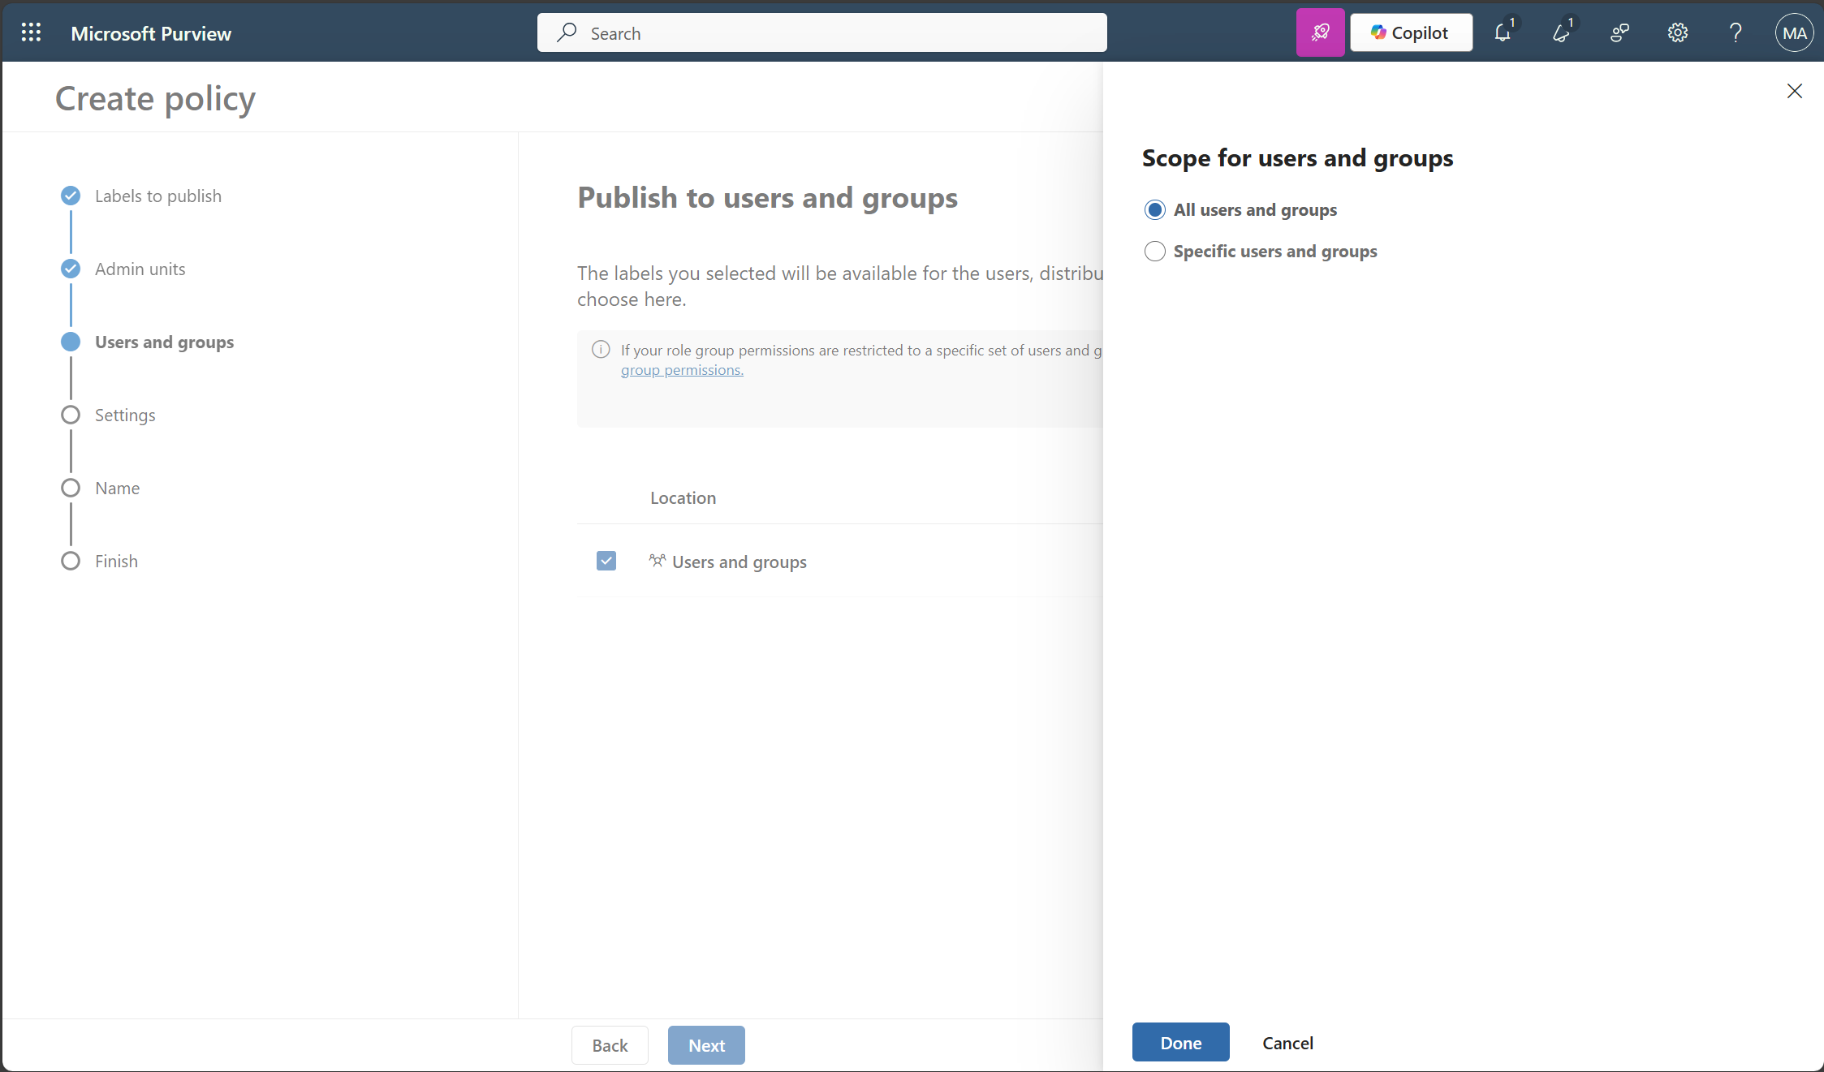
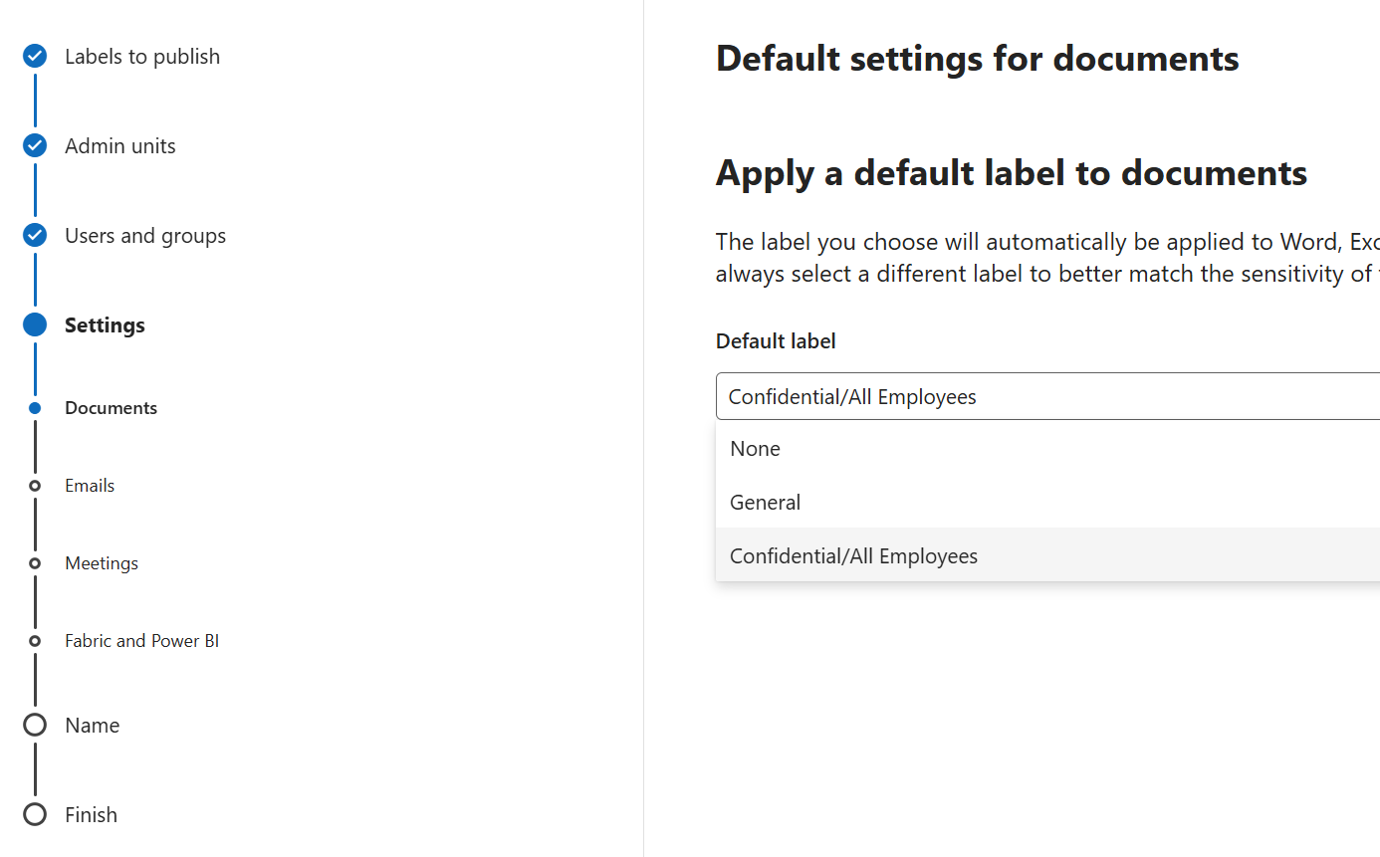
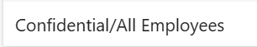
Protect your sensitive information
Publish sensitivity labels
Publishing your labels ensures users can see and use them. Automatically applying labels helps scale protection across Teams, SharePoint and OneDrive.
3
4
Available with Business Premium or above
How to do it
Go to purview.microsoft.com
Go to Solutions > Information protection
5
6
Select Policies > Label publishing policies > Publish label
Select sensitivity labels to publish, Add
Publish to All users and groups
6) Apply default label to documents, with Confidential/AllEmployees label
7) Name your policy
Learn more on our “Create and configure sensitivity labels and their policies” page
Notes:
Note: For labels and label policy settings, allow 24 hours for the changes to propagate through the services. However, there are some scenarios where label and label policy changes can take effect much faster or be longer than 24 hours.

Slide 8
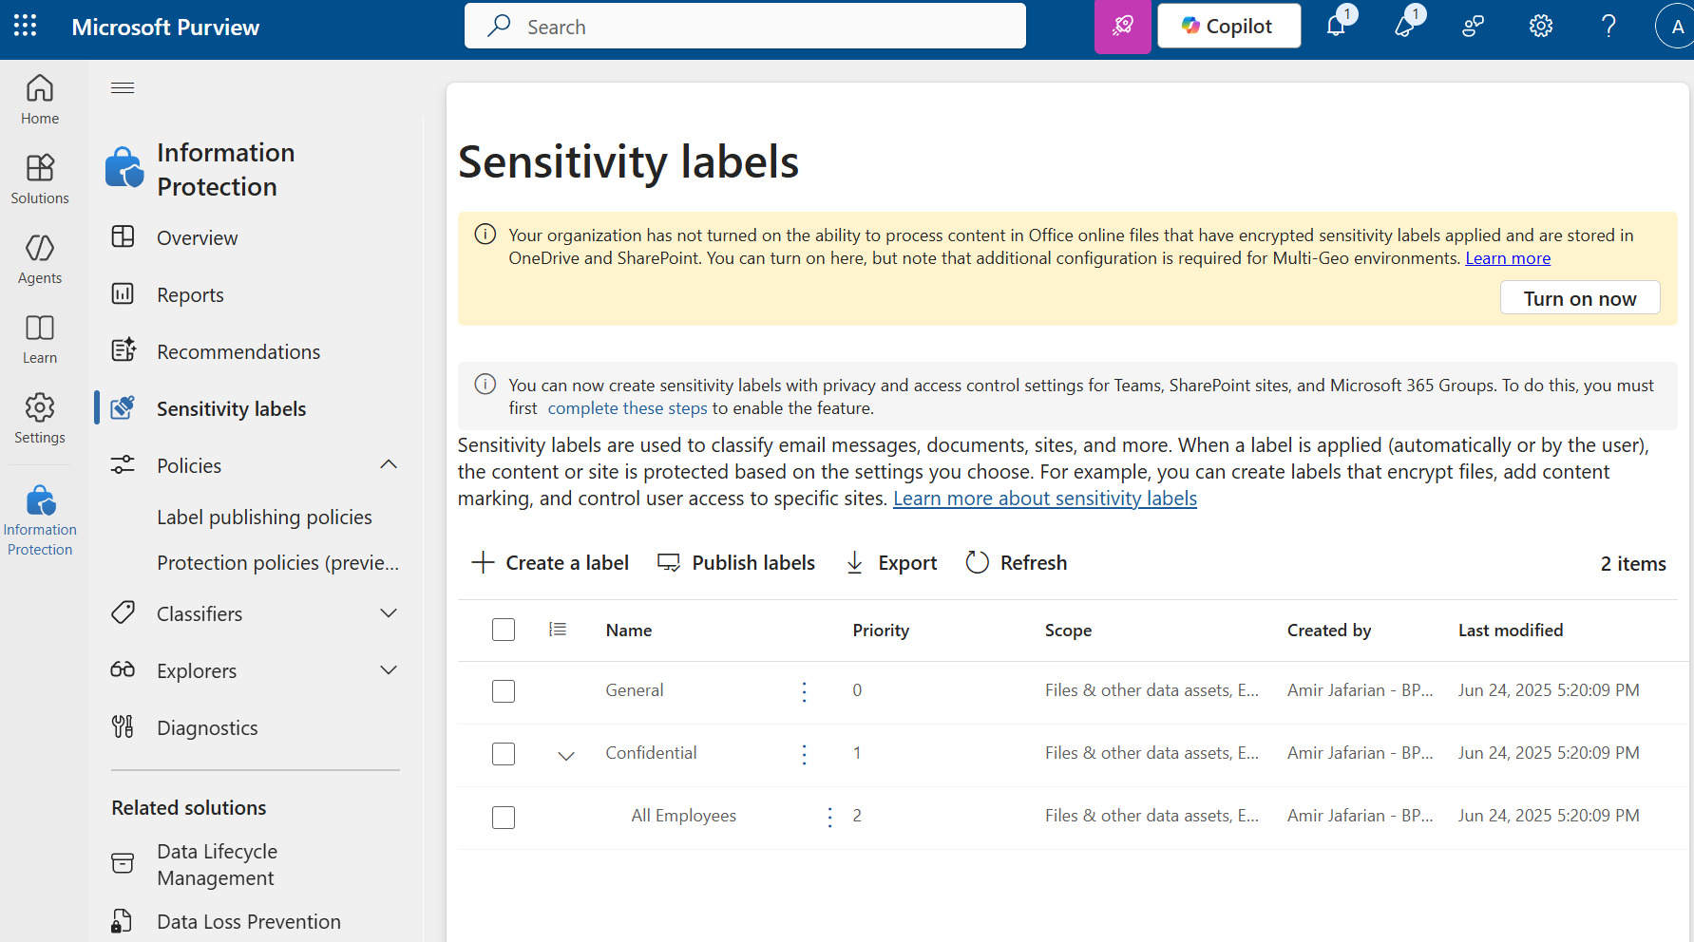
Protect your sensitive information
Enable OneDrive and SharePoint labels
1
2
Recognize and enforce sensitivity labels on files stored in SharePoint and OneDrive. This allows documents to inherit labels from libraries.
Available with Business Premium or above
3
How to do it
Go to purview.microsoft.com
Go to Solutions > Information protection
Under Sensitivity labels > If you see the following message, Select “Turn on now”:
“Your organization has not turned on the ability to process content in Office online files that have encrypted sensitivity labels applied and are stored in OneDrive and SharePoint. You can turn on here but note that additional configuration is required for Multi-Geo environments.”
Note: If you do not see this banner, the feature is likely already enabled.
Notes:
Note: For labels and label policy settings, allow 24 hours for the changes to propagate through the services. However, there are some scenarios where label and label policy changes can take effect much faster or be longer than 24 hours.

Slide 9
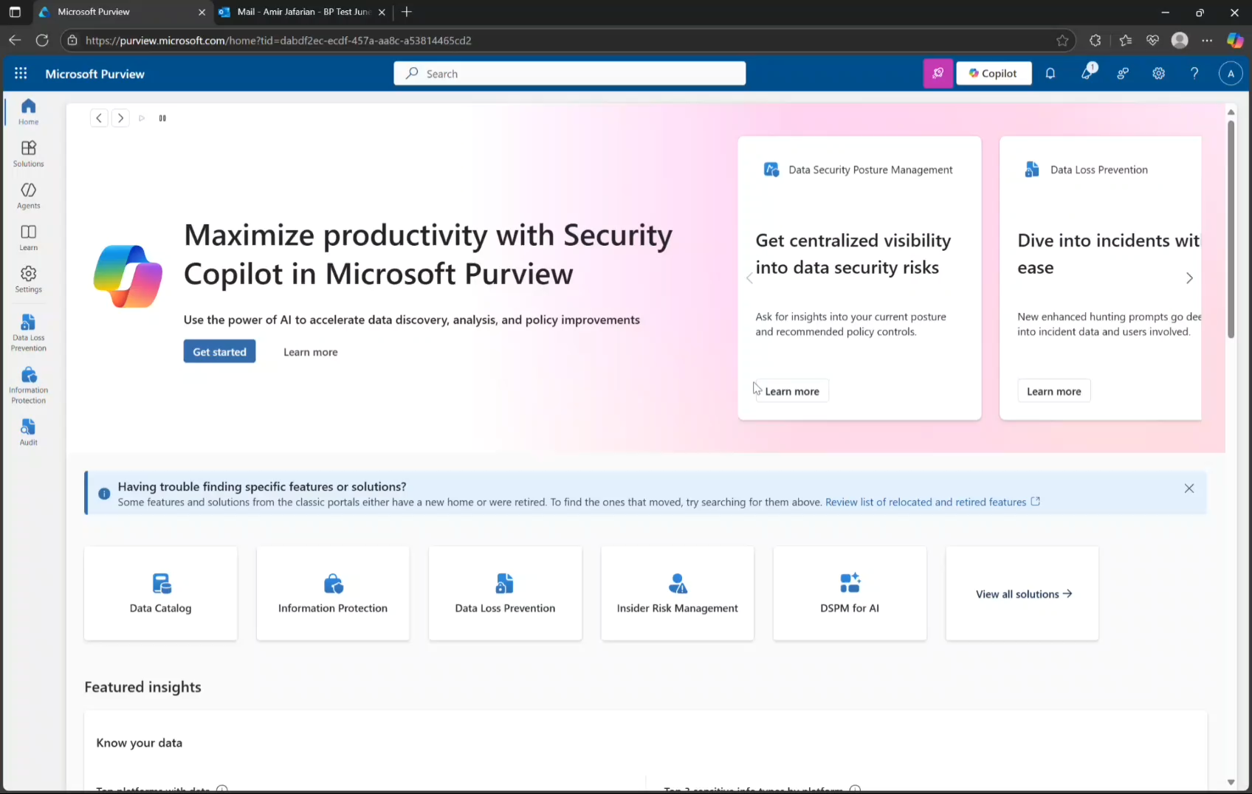
Create and deploy DLP policies
Block sharing of sensitive information
Create Microsoft Purview DLP policies for Exchange, SharePoint, and OneDrive to prevent sharing of labeled content. These policies help enforce internal-only access by blocking external sharing, forwarding, or downloading of sensitive files and emails — ensuring consistent protection across Microsoft 365.
Available with Business Premium or above
How to do it
Go to purview.microsoft.com >Go to Solutions > Data Loss Prevention
2) Go to Policies > +Create policy > Data stored in connected sources
3) Choose template: Custom policy and name Policy
4) Choose locations: Policy 1: Exchange email; Policy 2: SharePoint sites, OneDrive accounts [Best practice is to have separate DLP policy for Exchange]
5) Create rule and define:
Conditions: content is labeled Confidential/AllEmployees
Actions: Block sharing with people outside the organization
6) Select Policy mode: Turn on the policy immediately
Learn more on our “Design a data loss prevention policy” and “Create and Deploy data loss prevention policies” pages

Slide 10
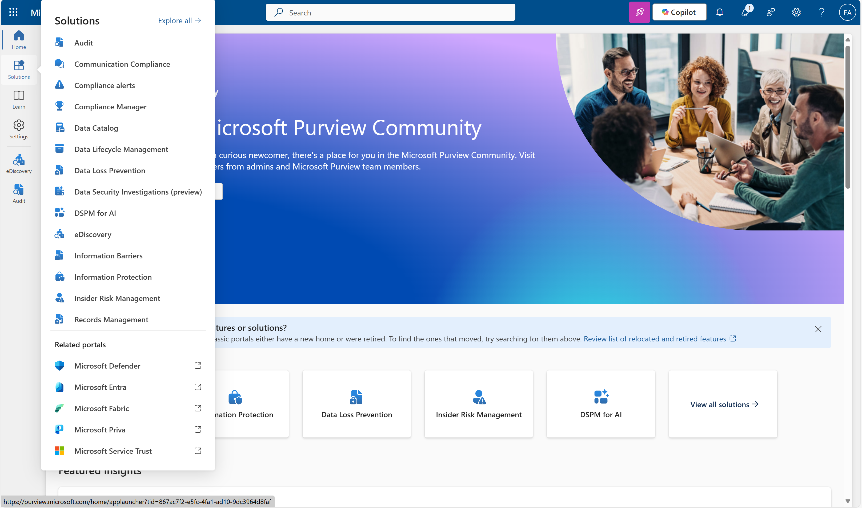
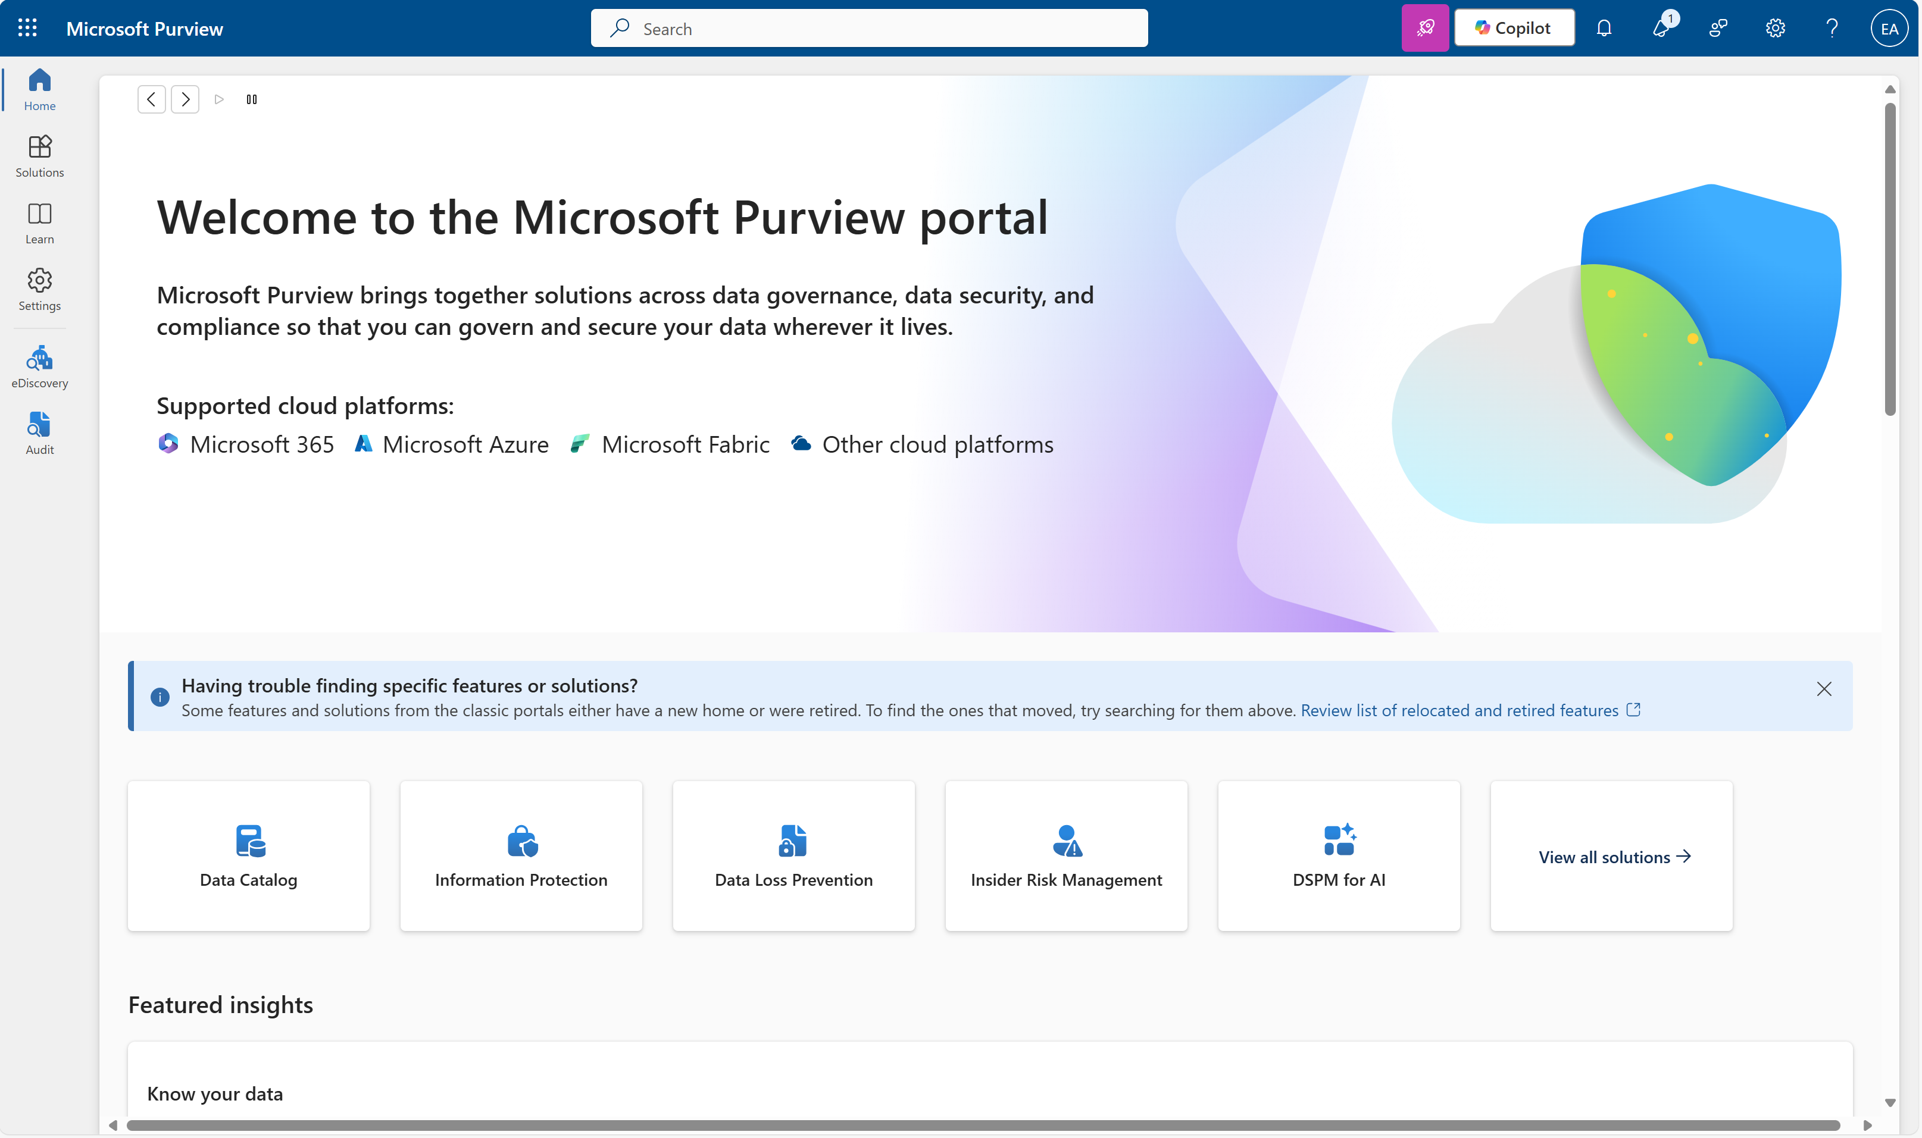
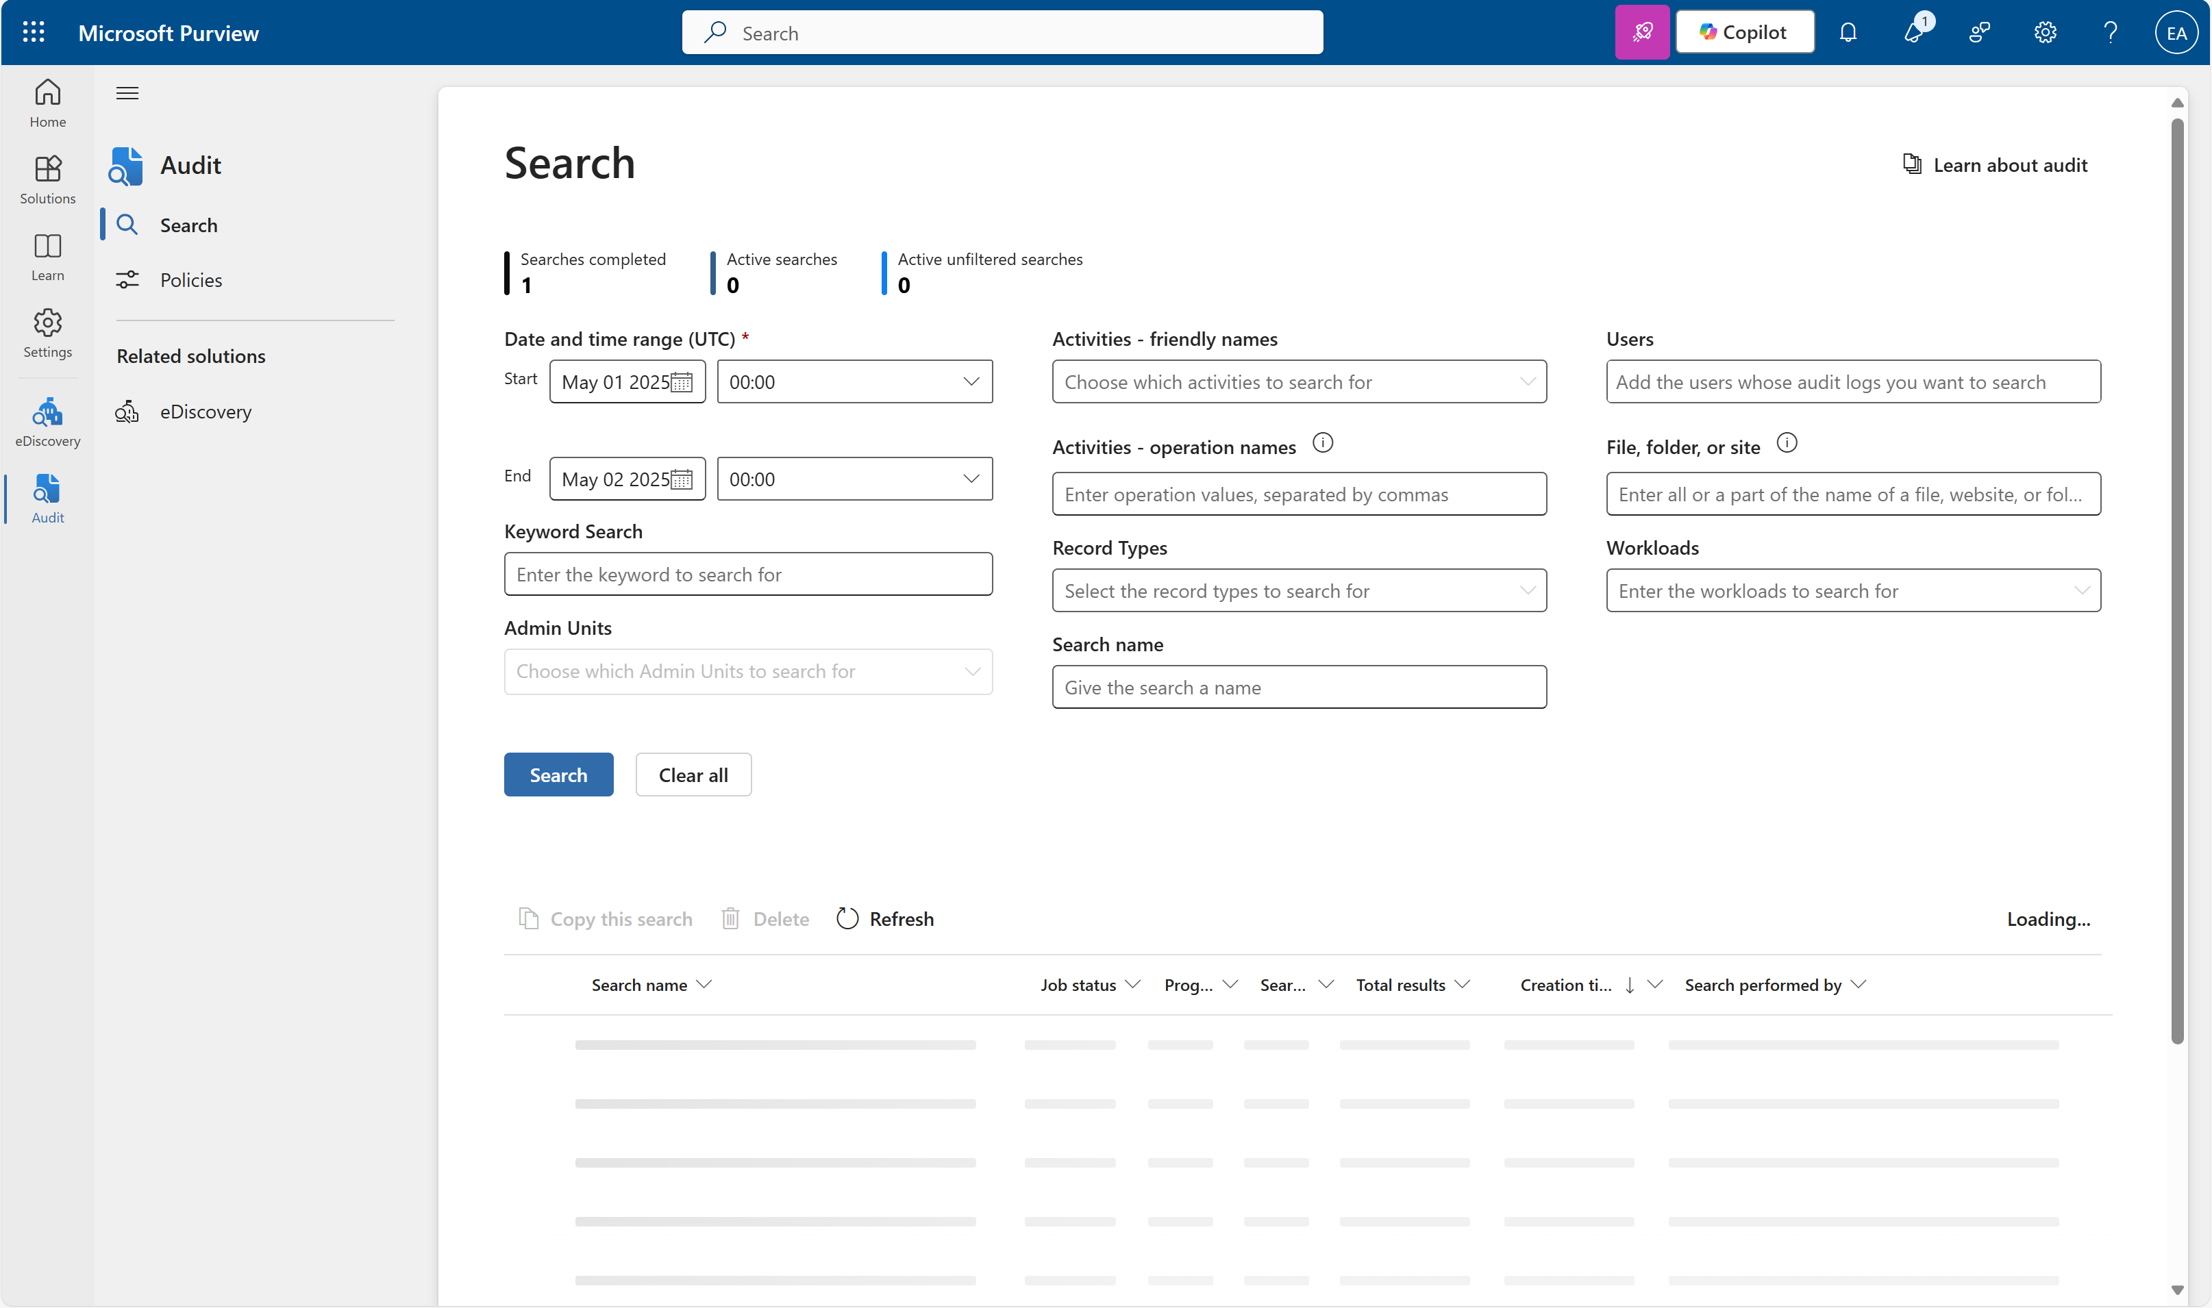
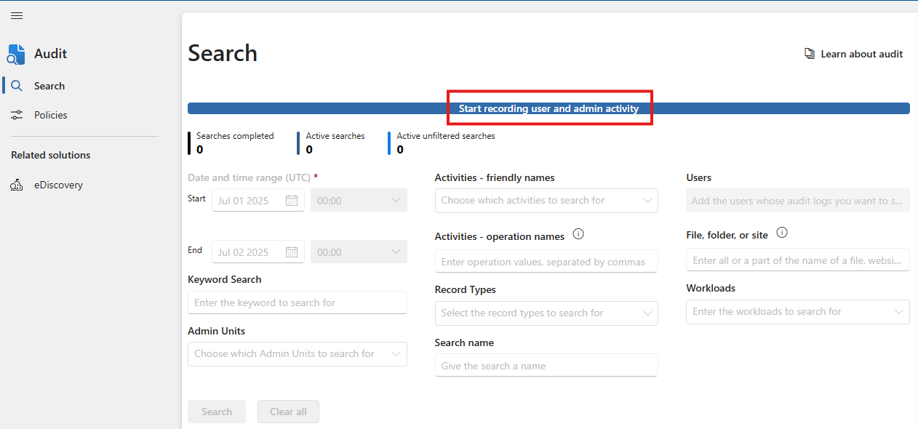
Enable audit logging
Protect your sensitive information
Audit logs track user and admin activity, including Copilot interactions. Even though auditing is usually turned on by default, confirming it's active ensures no gap in visibility.
1
2
3
Available with Business Premium or above
How to do it
Go to purview.microsoft.com
In the left-hand navigation, select Solutions
4
5
6
In the Solutions catalog, click Audit
If audit logging is already enabled, you will see the Search interface
If it’s not enabled, click Start recording user and admin activity at the top of the page
Wait up to 60 minutes for auditing to activate
Learn more on our “Turn auditing on or off ” page. You must be assigned the Audit Logs role in Exchange Online to turn auditing on or off.

Slide 11
Better
Protect your sensitive information
Block the sharing of sensitive information
Create sensitivity labels
Create sensitivity sub-labels
Publish sensitivity labels
Set as default label
Enable OneDrive and SharePoint labels
Enable Audit logging
Create custom sensitive info types (SIT)
Configure client-side auto-labeling
Create and deploy DLP policies across:
Exchange
SharePoint
OneDrive
Teams
Endpoints
Apply email protection

Slide 12
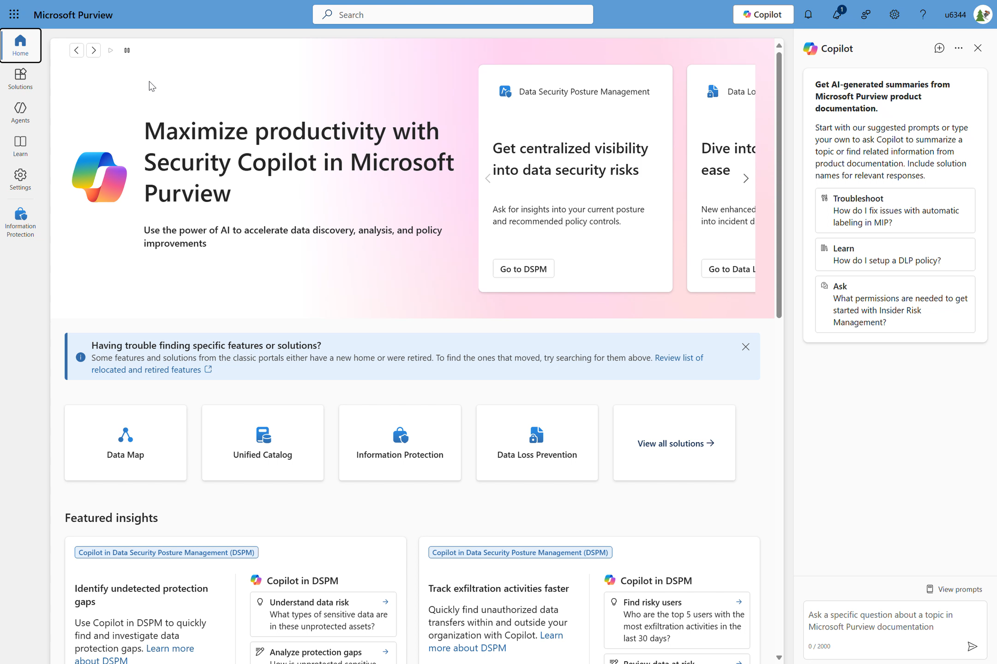
Create custom sensitive info types
Protect your sensitive information
Examples of custom sensitive info types:
Name | Pattern Type | Example match
Employee ID | Regex | EMP-123456
Internal Project Code | Keyword list | Project Falcon, Orion, Phoenix
Proprietary source code | Regex + keyword | Code snippets containing ‘internal_use=true’ near class or function
Credit Card Number | Function | Built-in function detects patterns like 4111 1111 1111 1111 (Visa)
Custom sensitive information types (SITs) allow you to detect and classify data unique to your organization – such as internal IDs, project codes, propriety source code – and use them in auto-labeling or DLP policies.
Available with IPG or above
How to do it
Go to purview.microsoft.com
Go to Solution > Information protection
3) Go to Classifiers > Sensitive info types
4) Click +Create info type
5) Define:
Name and description
Confidence levels
Primary element: keyword list, regex, or function
Character proximity
Supporting elements (e.g. proximity keywords)
6) Save and publish
Learn more on our “Create and configure sensitivity labels and their policies” page

Slide 13
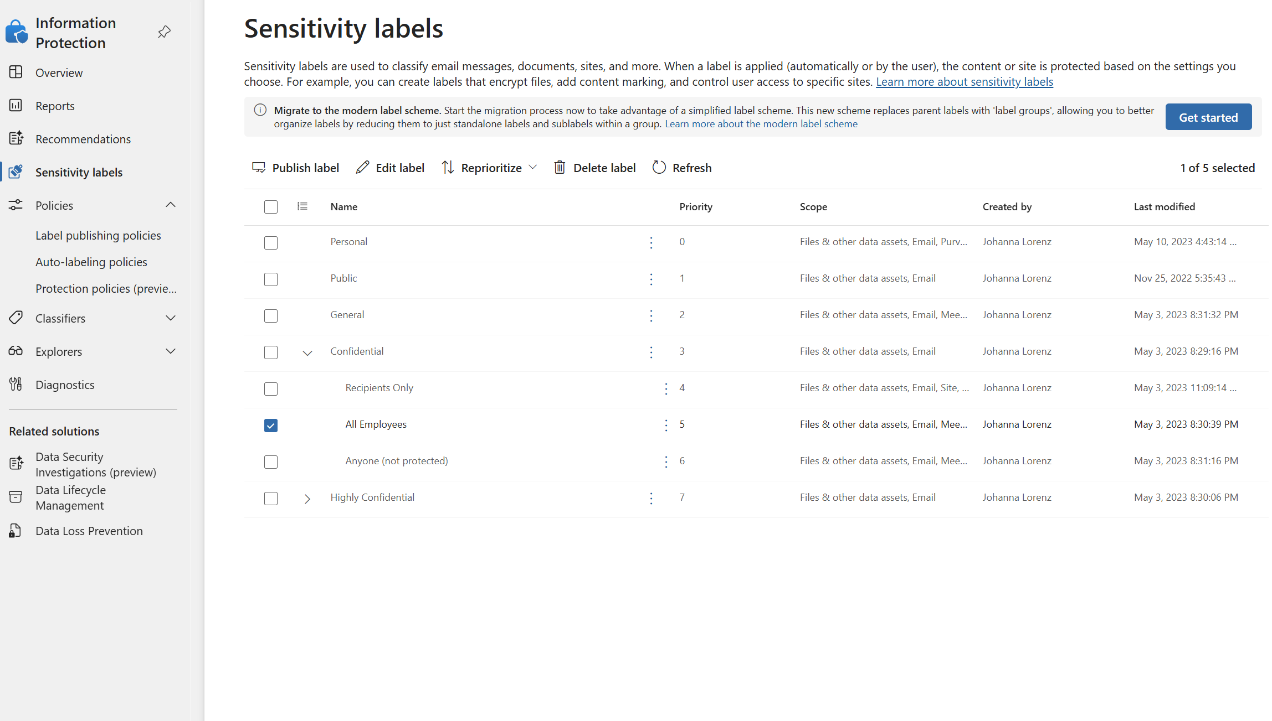
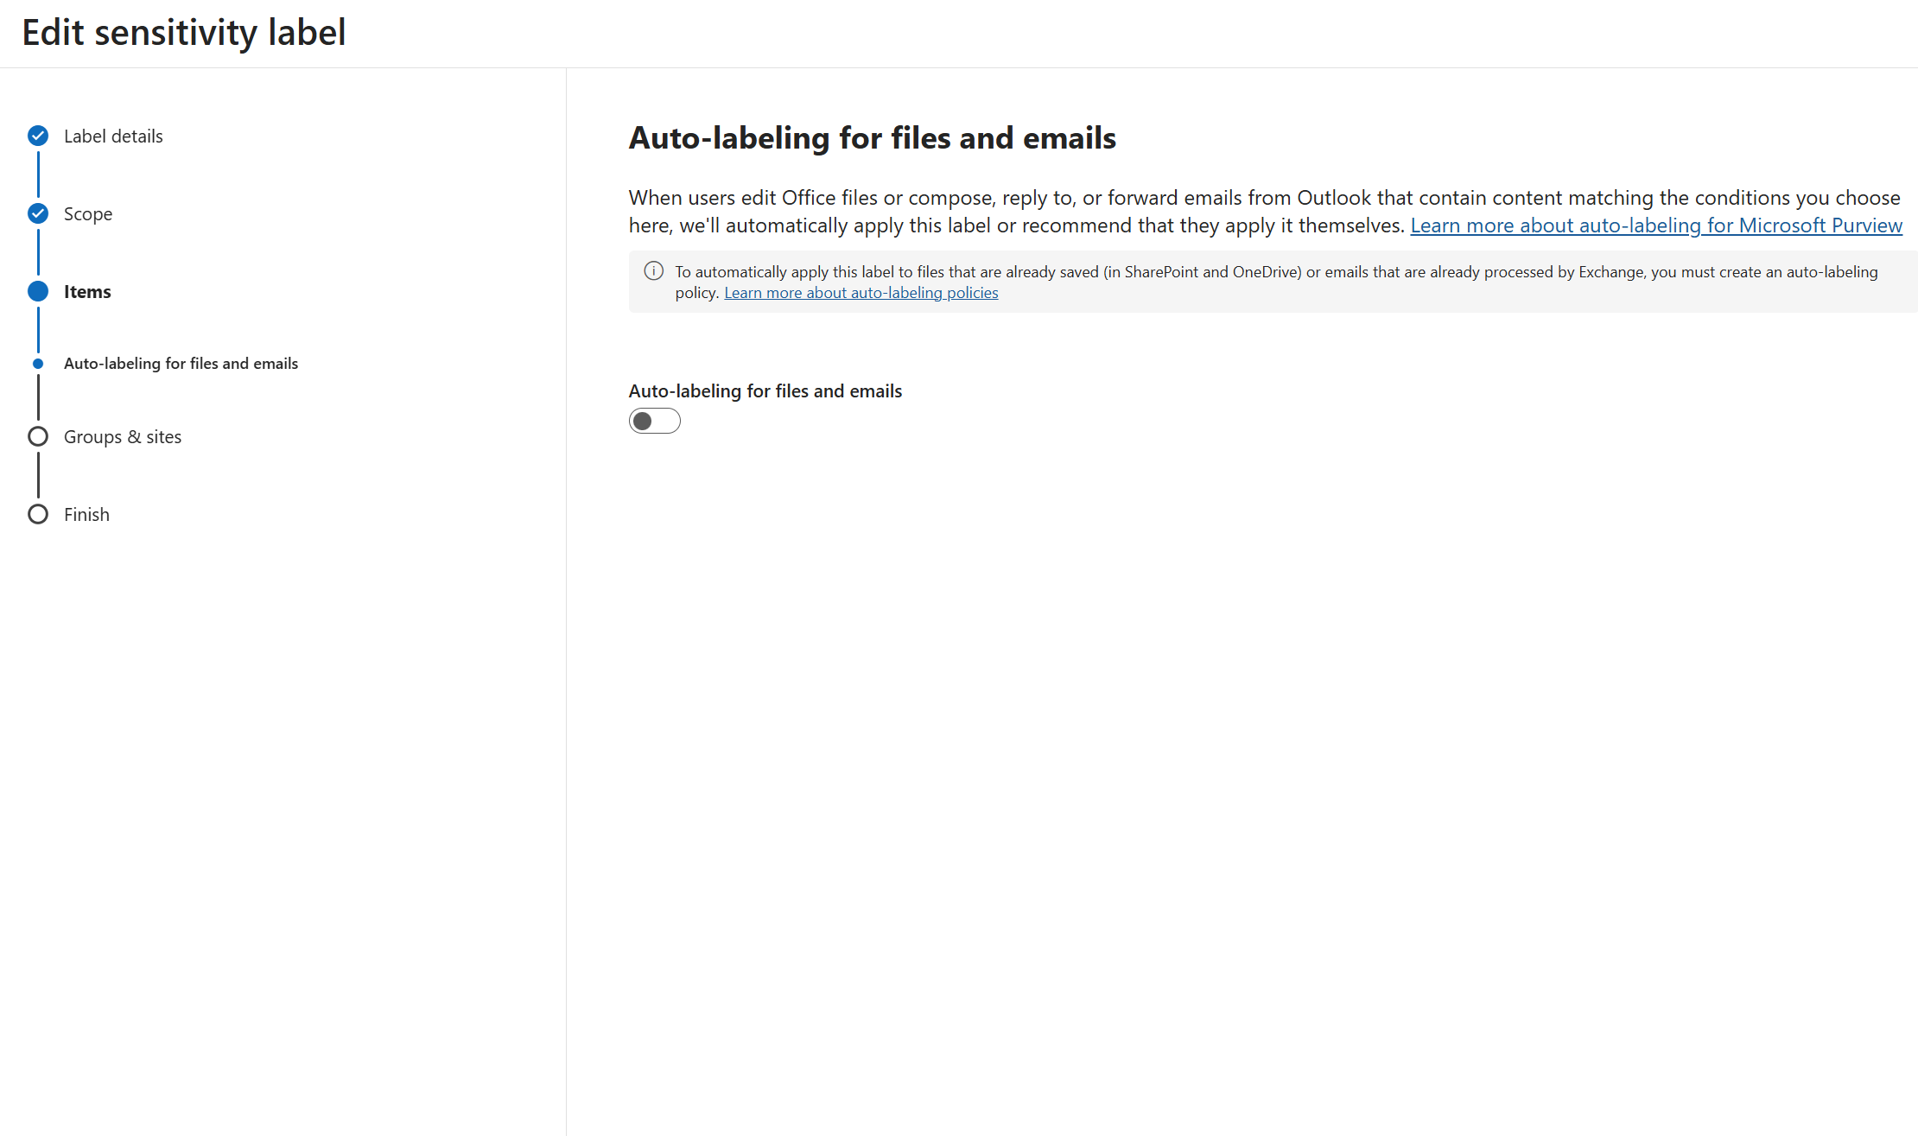
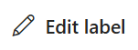
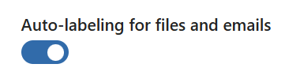
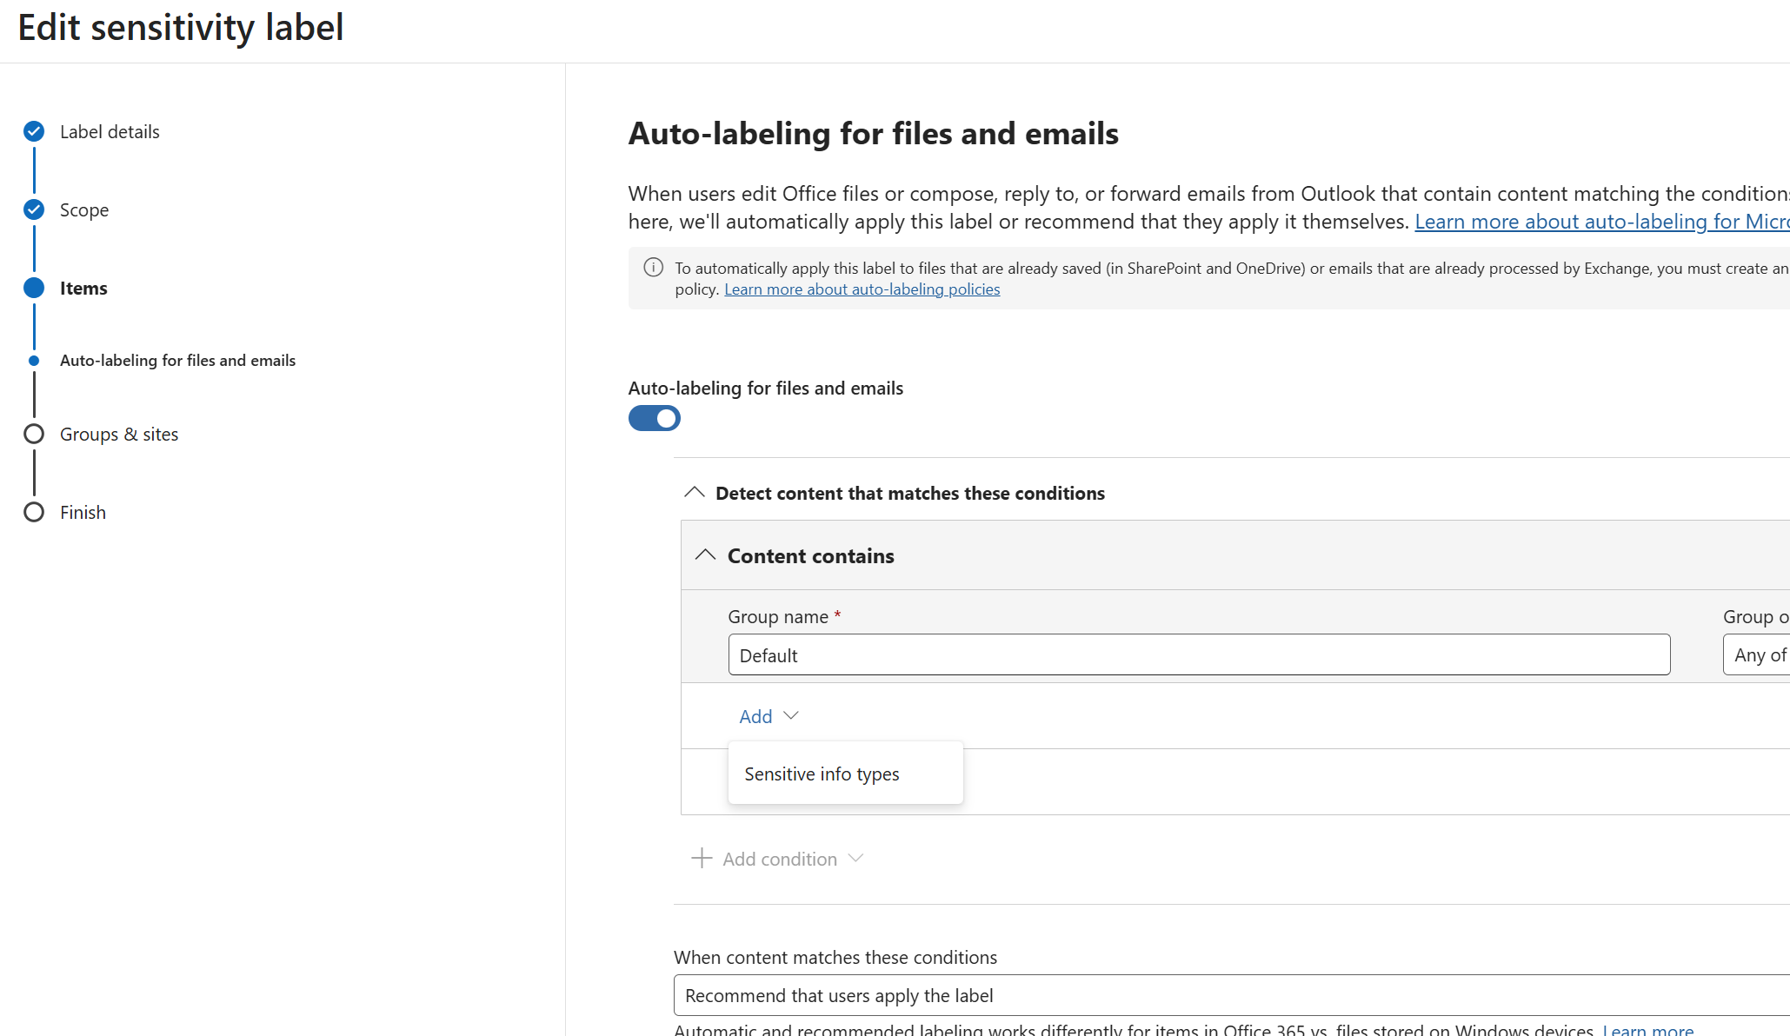
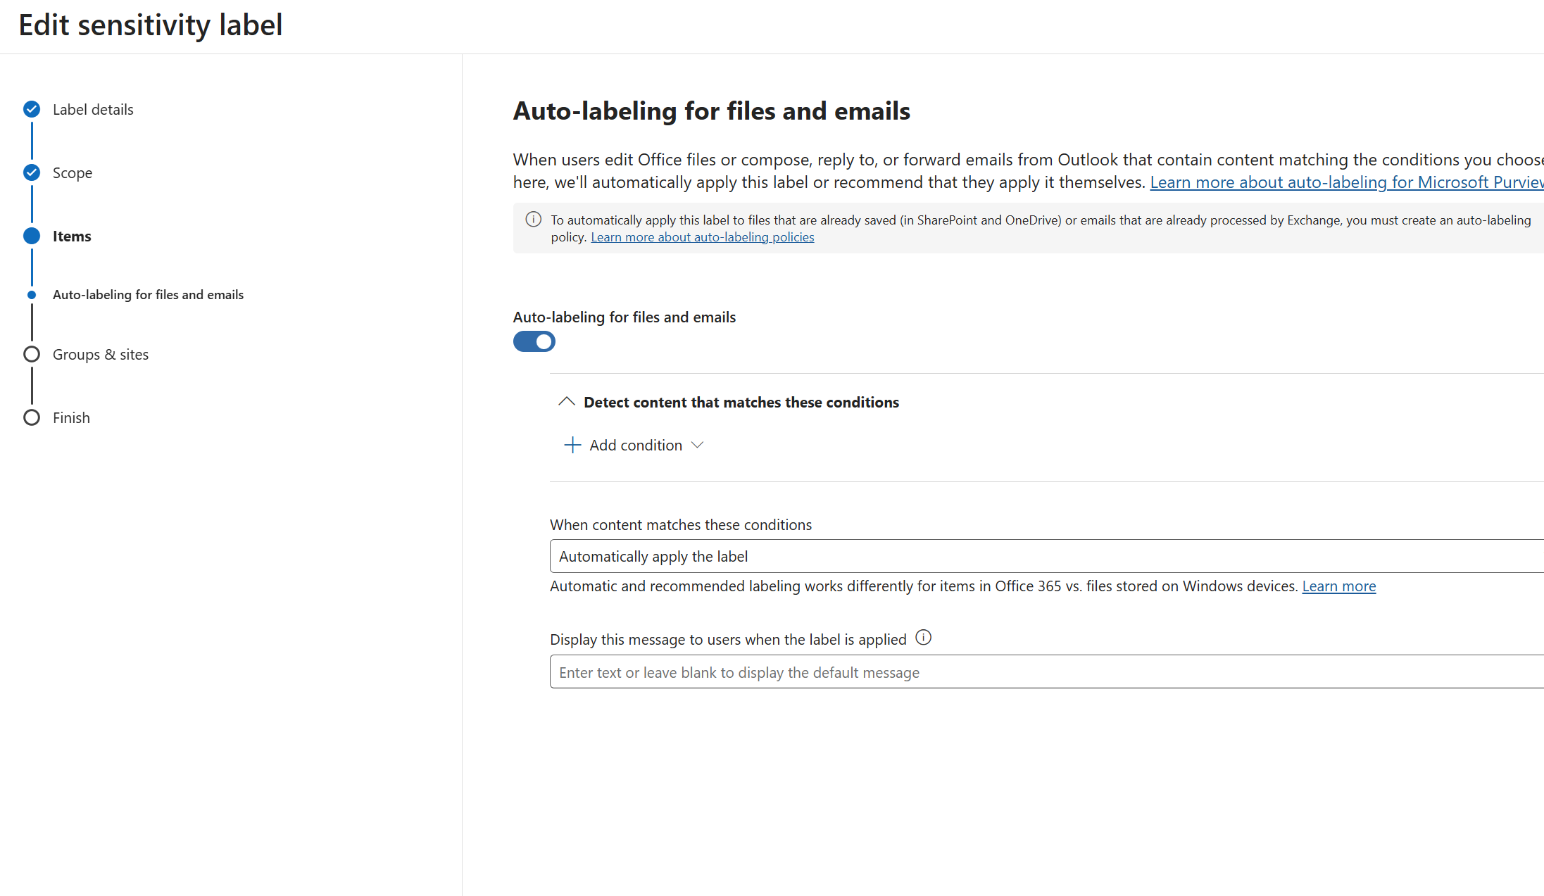
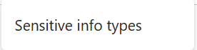
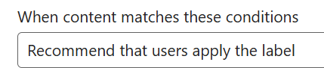
Configure client-side auto-labeling
Protect your sensitive information
Client-side auto-labeling helps classify and protect content as users create or edit it in M365 apps like Word, Excel and Outlook. This ensures consistent labeling without relying on manual user action.
2
3
Available with IPG or above
How to do it
1) Go to purview.microsoft.com > Solutions > Information protection
2) Go to Sensitivity Labels > Select the Confidential/AllEmployees label and Edit label
4
5
3) Under Auto-labeling for files and emails > Toggle On
4) Add condition > Content contains > Add custom sensitive information types
5) Change ‘When content matches these conditions from Automatically apply the label > Recommend that users apply the bale
6) Save label
Learn more on our “Automatically apply a sensitivity label to Microsoft 365 data | Microsoft Learn” page

Slide 14
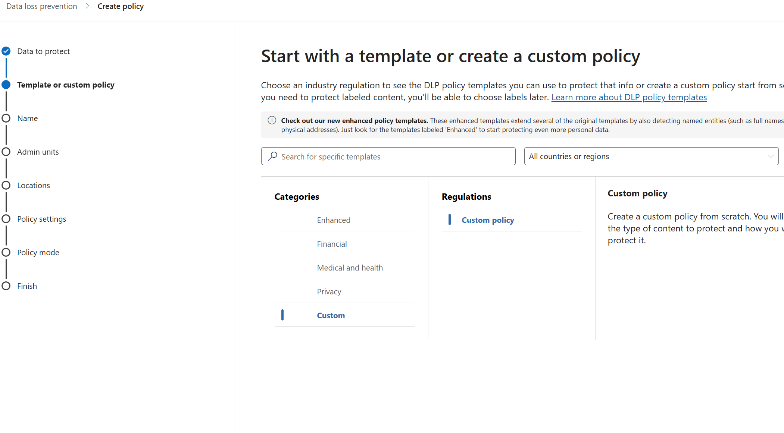
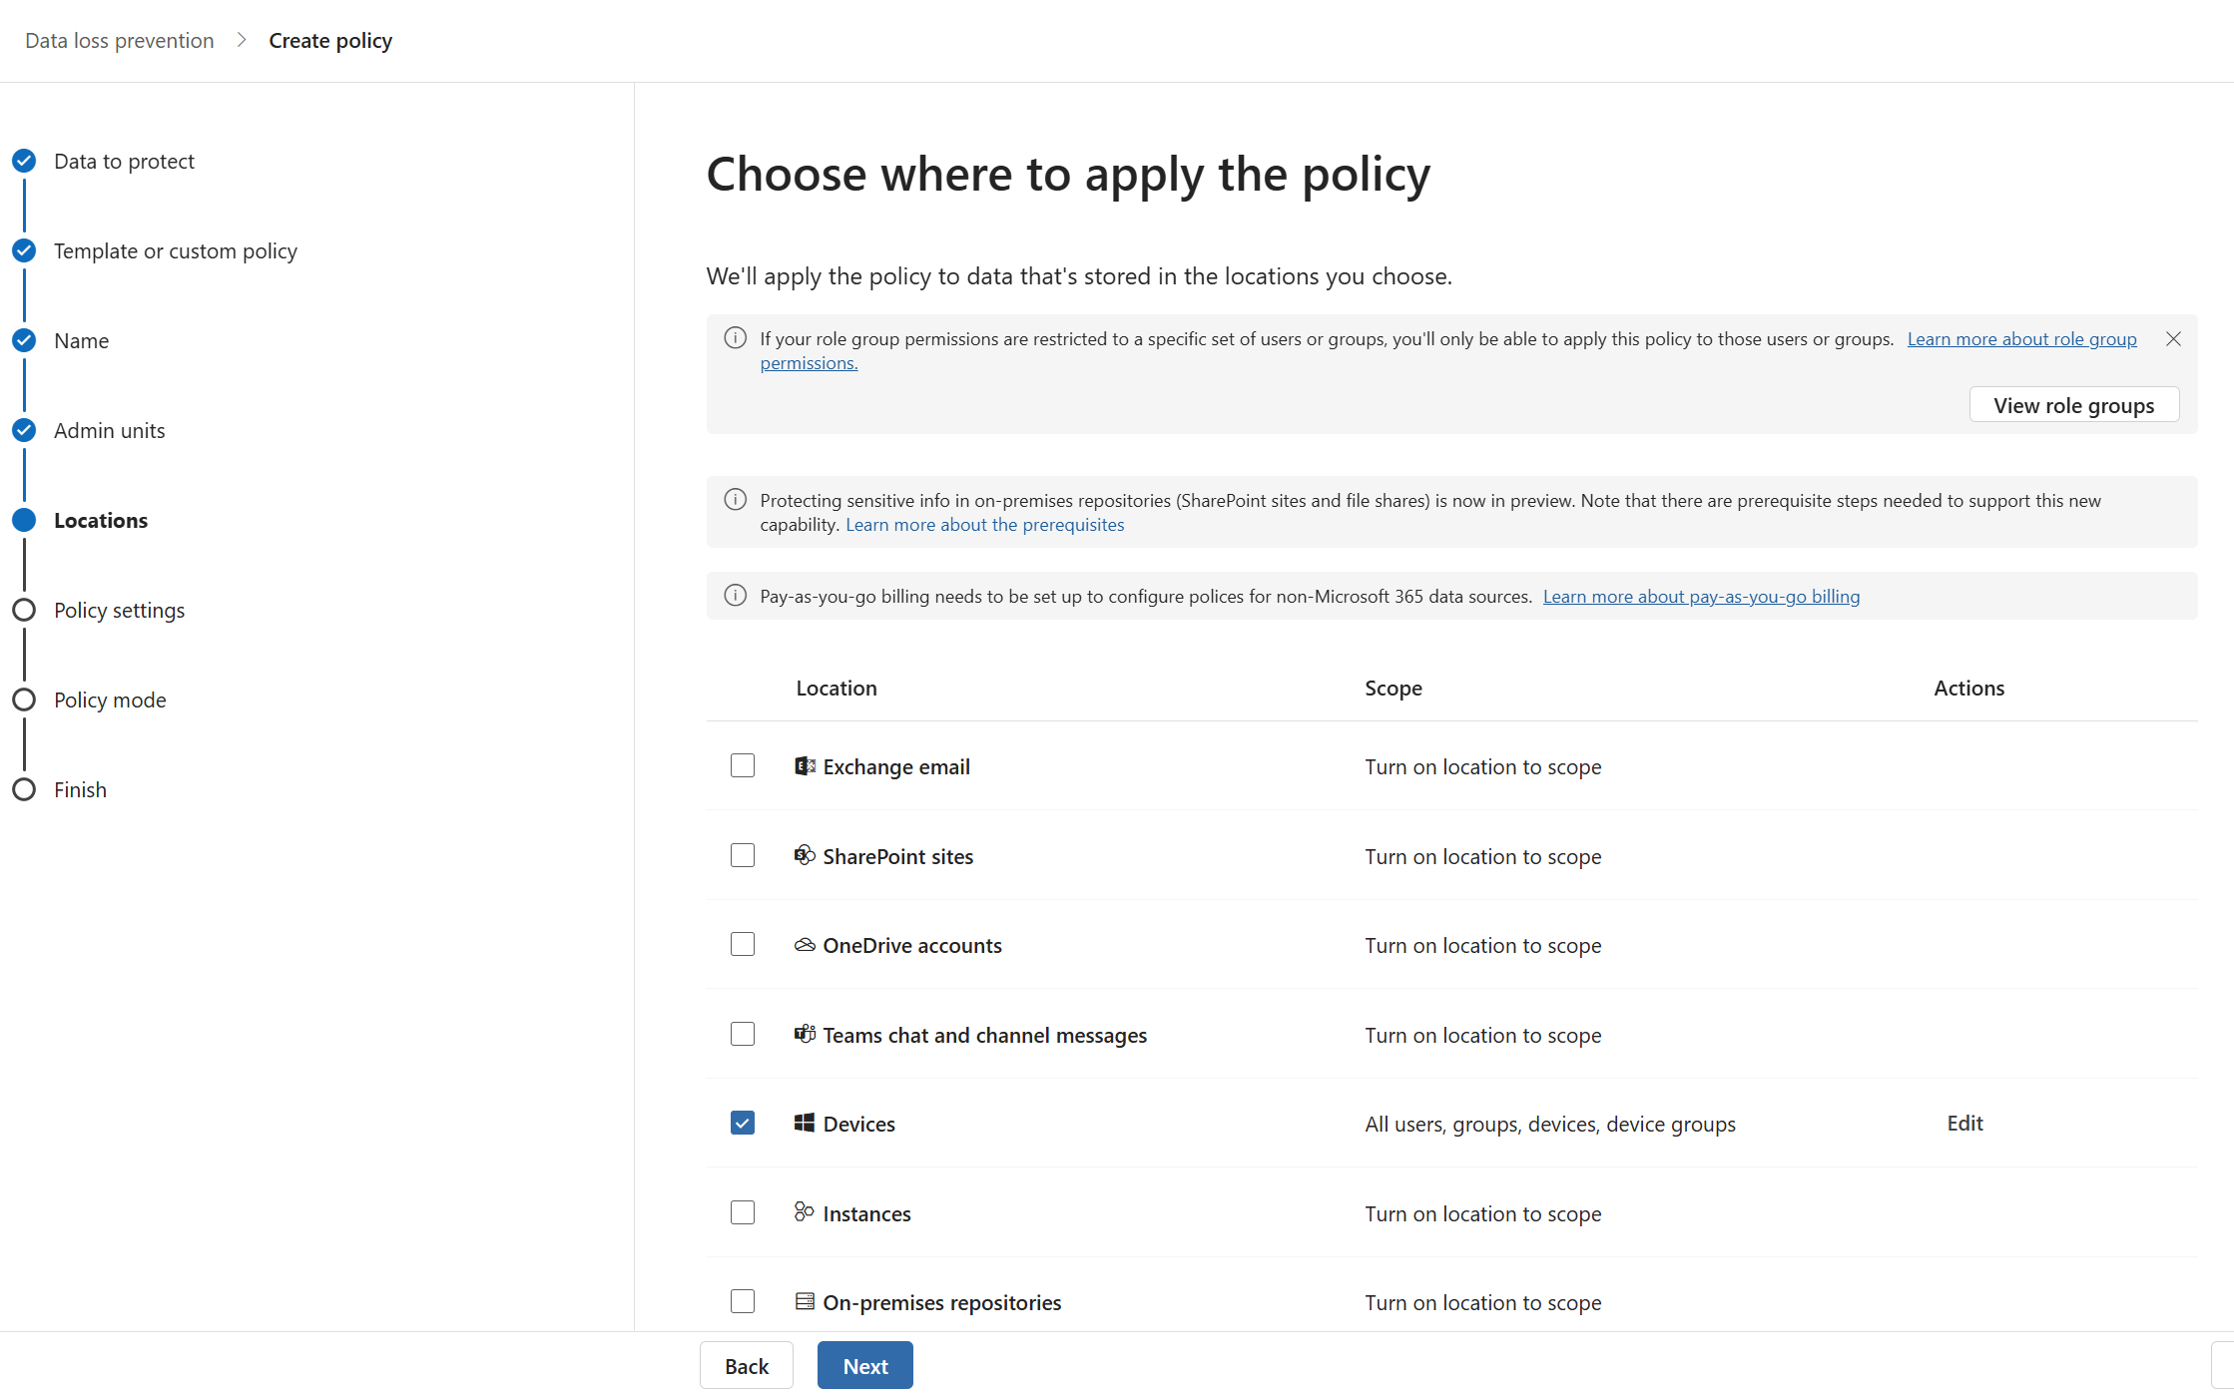
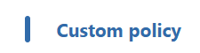
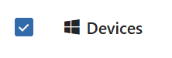
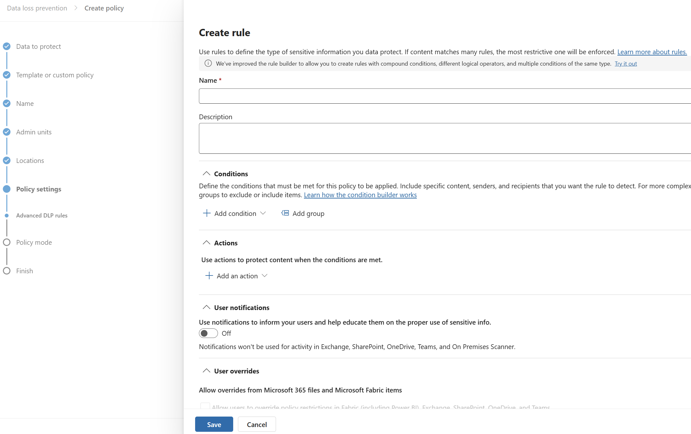
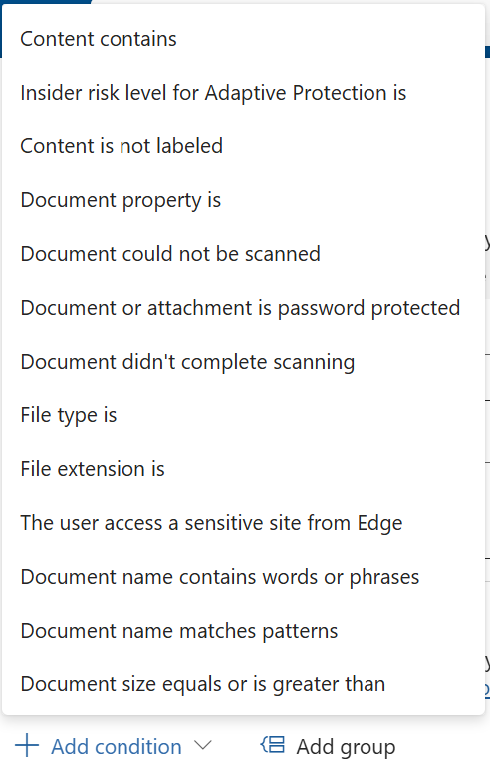
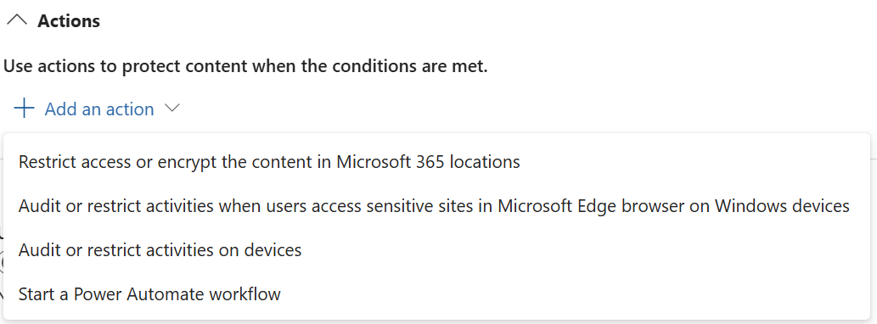
Create DLP policy for endpoints
Block the sharing of sensitive information
Endpoint DLP helps prevent sensitive data from being copied to USB drives, printed, or uploaded to unapproved apps. This protects data on Windows 10/11 devices enrolled with Microsoft Purview.
4
5
Available with IPG or above
How to do it
Go to purview.microsoft.com
Go to Solutions > Data Loss Prevention
6
6
Go to Policies > +Create policy > Data stored in connected sources
Choose template: Custom policy
5) Name policy and choose devices as the location
Create rule and define:
Conditions: content contains custom SITs or Confidential/AllEmployees sensitivity label
Actions: Audit or restrict activities on devices: block copy to USB, print, clipboard or browser upload
7) Run in simulation mode or turn on and submit
Learn more on our “Create and deploy a data loss prevention policy | Microsoft Learn” page

Slide 15
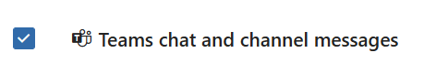
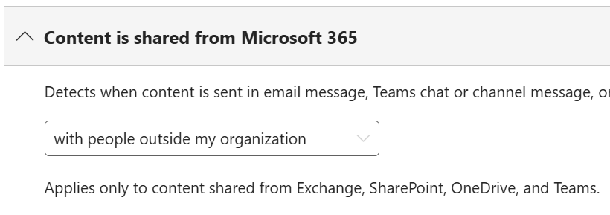
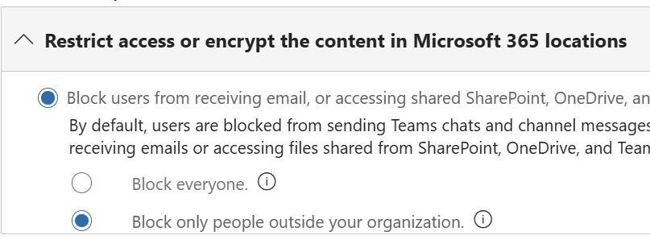
Create DLP policy for Teams
Block the sharing of sensitive information
Prevent sensitive data from being shared in chat or channel messages with external users or guests. This protects communications and documents in Microsoft Teams environments by automatically blocking or deleting messages and restricting access to sensitive files.
3
4
Available with IPG or above
How to do it
Go to purview.microsoft.com > Solutions > Data Loss Prevention
2) Go to Policies > +Create policy > Data stored in connected sources > Choose template: Custom policy
5
6
3) Name policy and choose Teams chat and channel messages as the location
4) Create rule and select Conditions > Content contains custom SITs or Confidential/AllEmployees sensitivity label
5) Add Condition > Content is shared from M365 and select with people outside my organization
6) Add Action > Restrict access or encrypt the content in M365 locations > Block only people outside your organization
7) Run in simulation mode or turn on and submit
Learn more on our “Create and deploy a data loss prevention policy | Microsoft Learn” page

Slide 16
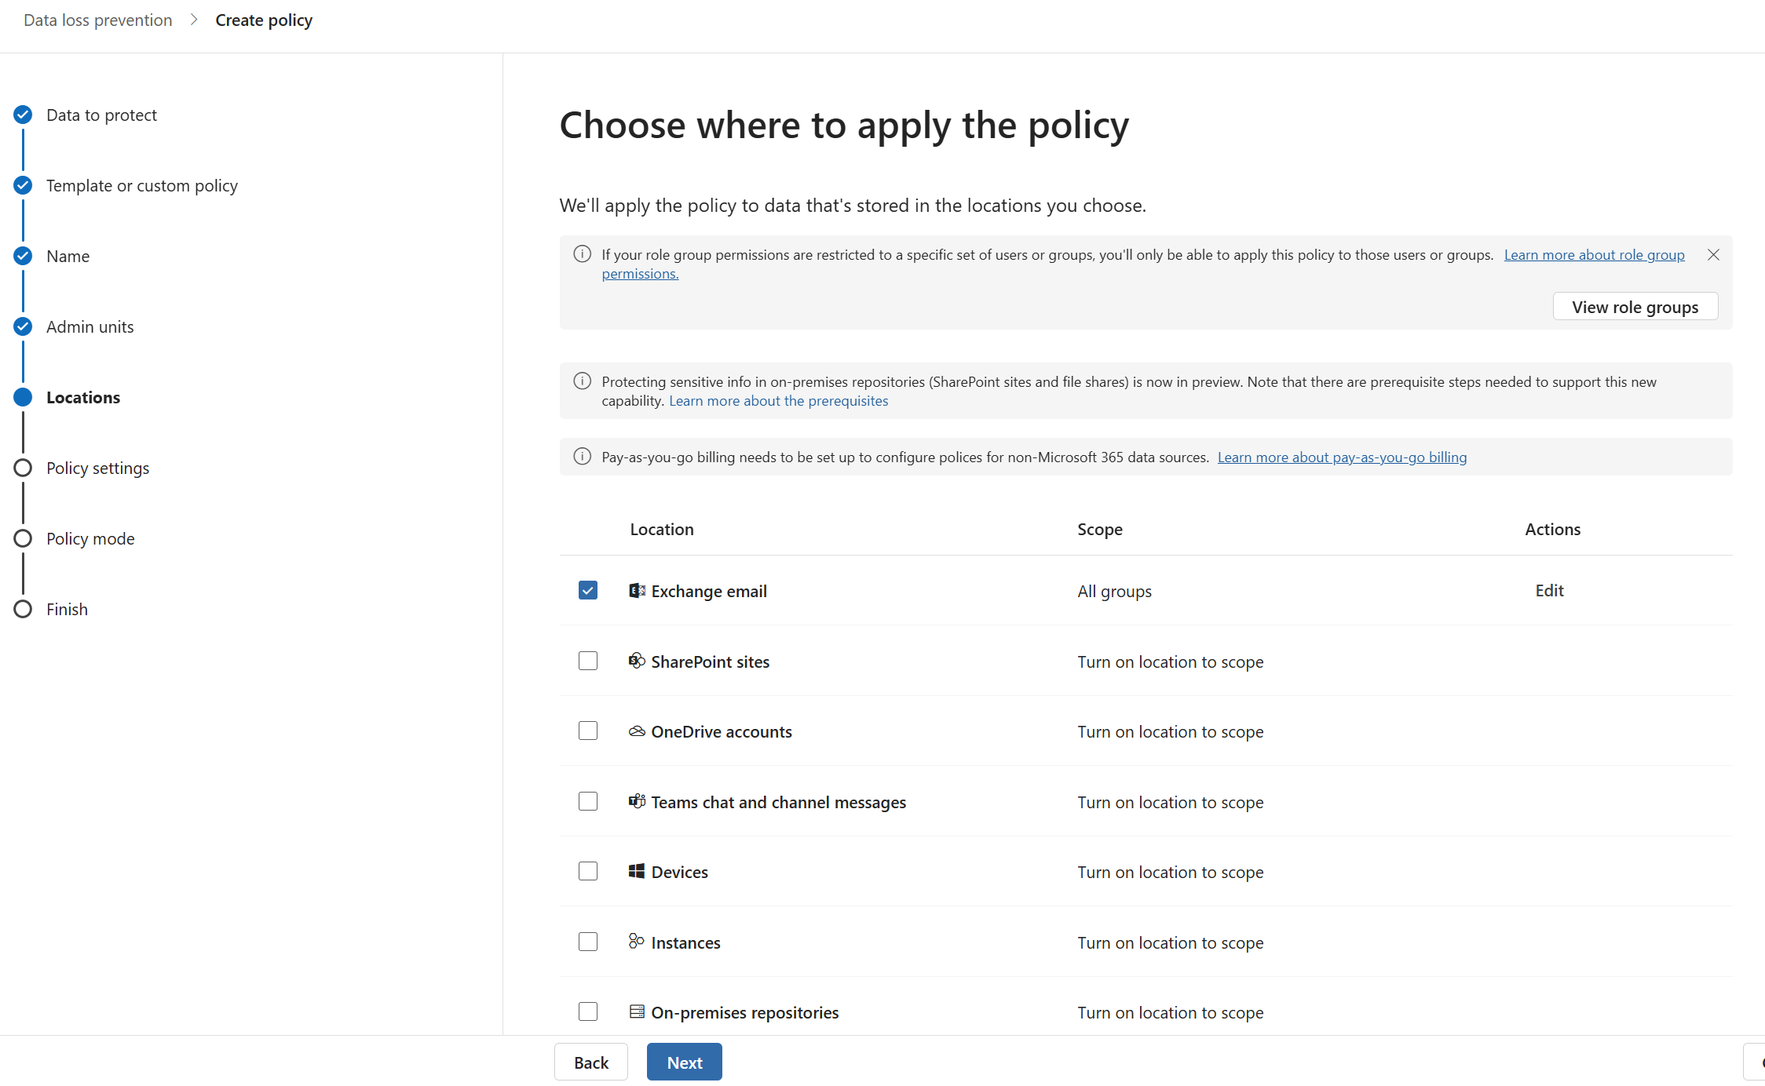
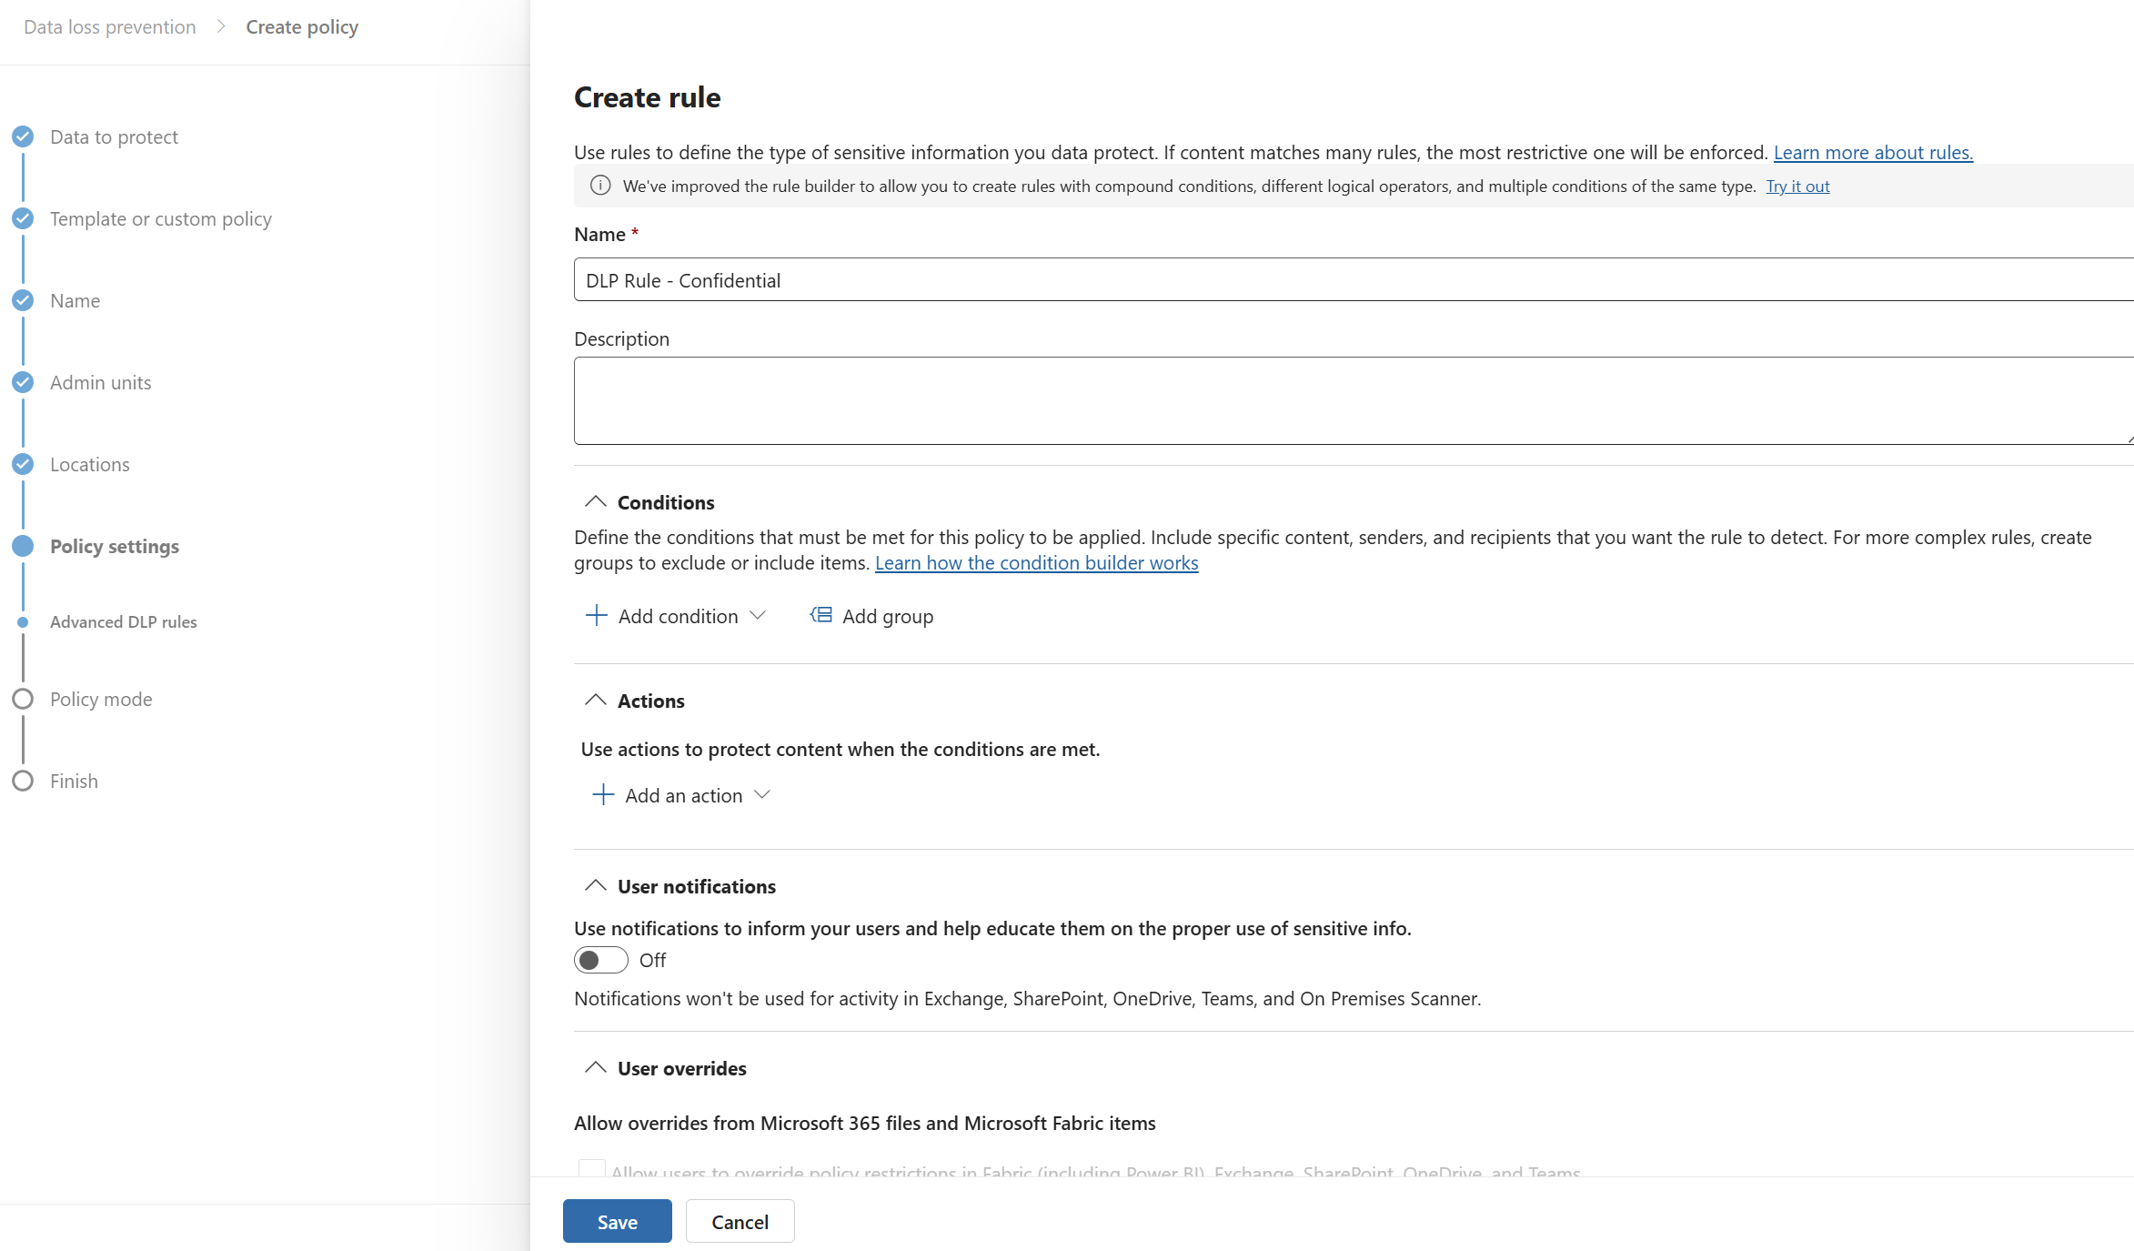
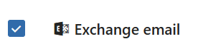
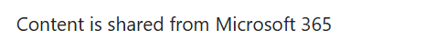
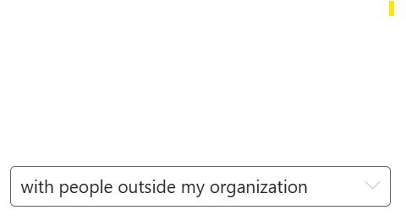
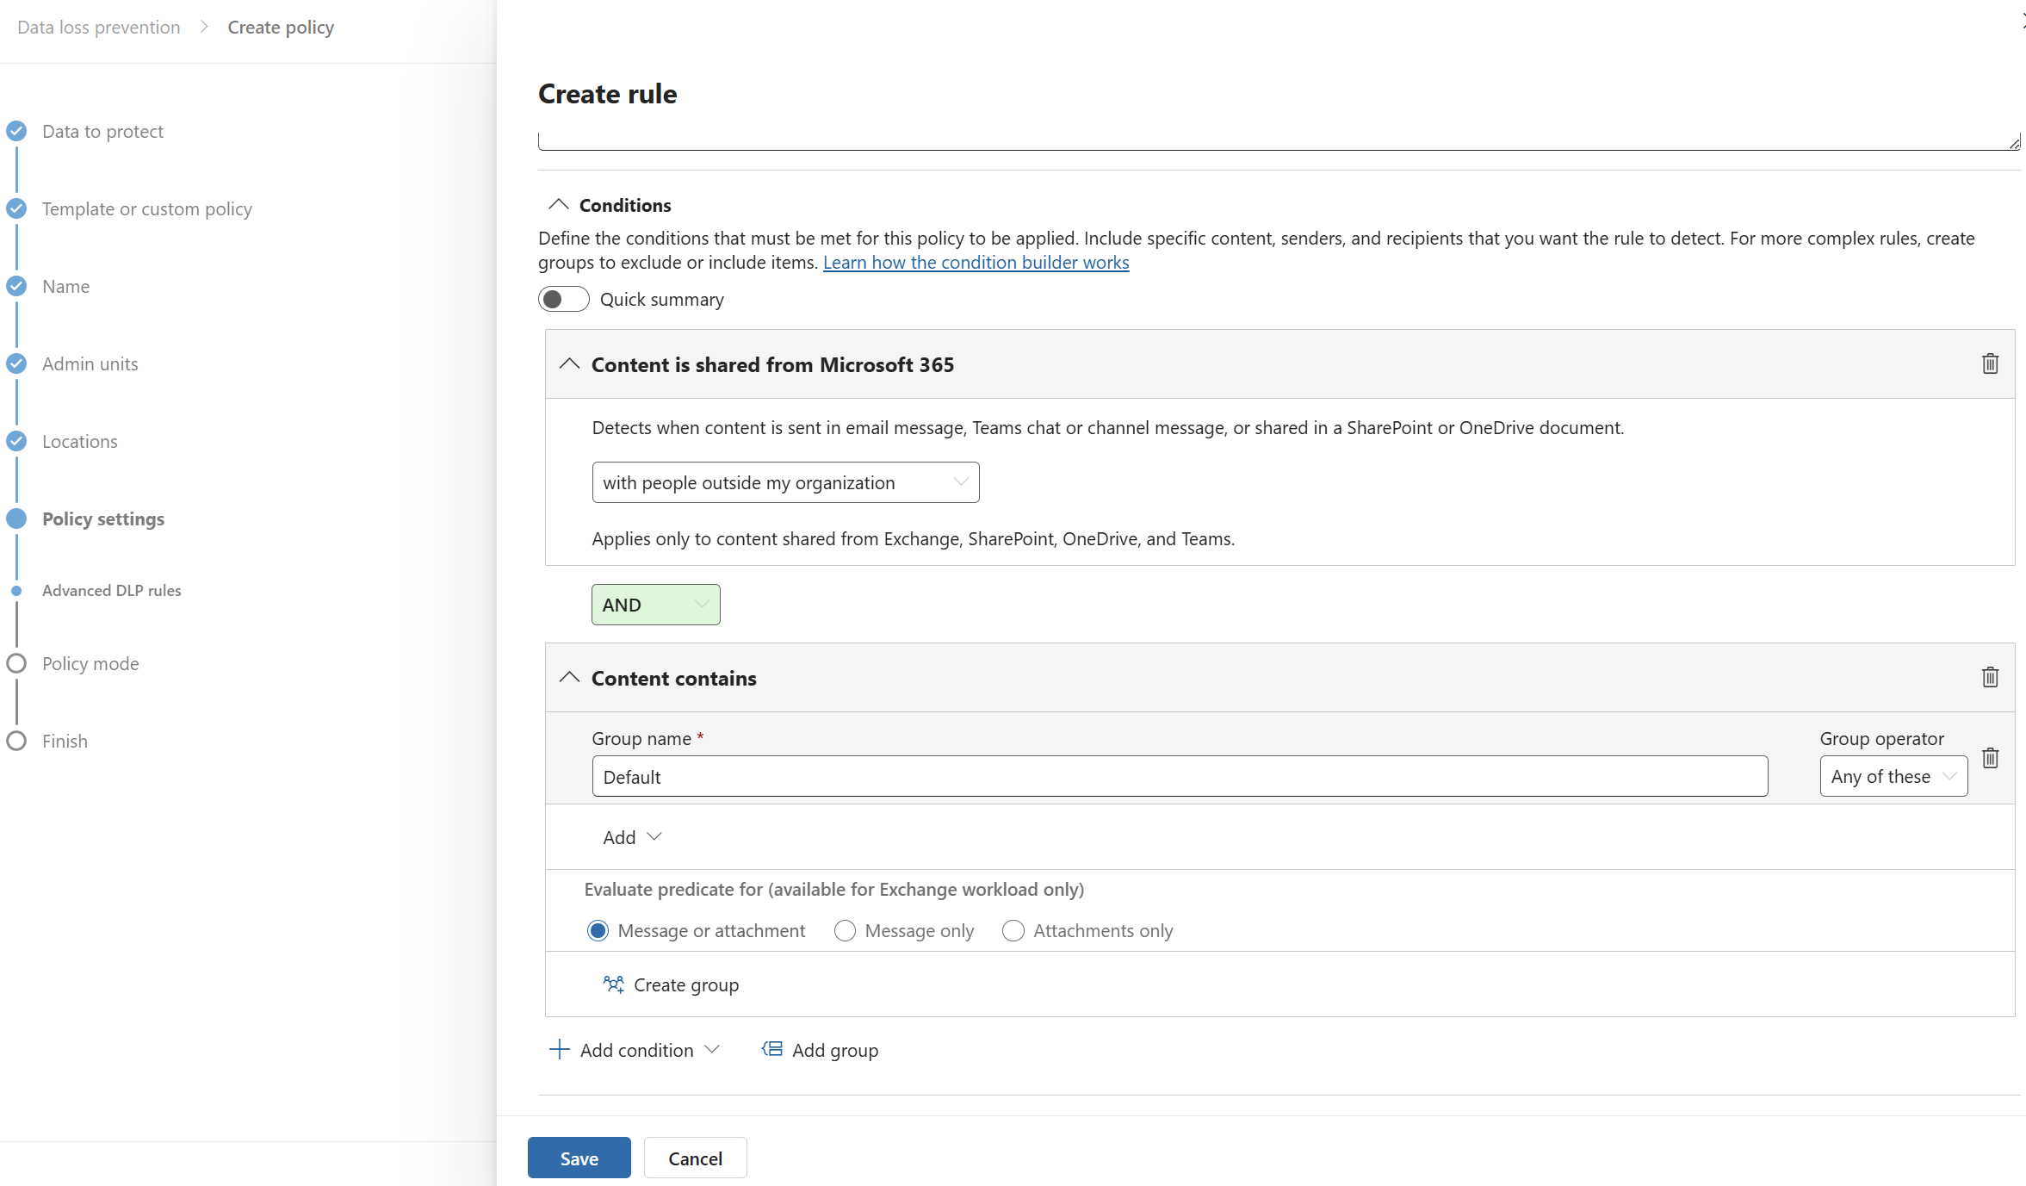
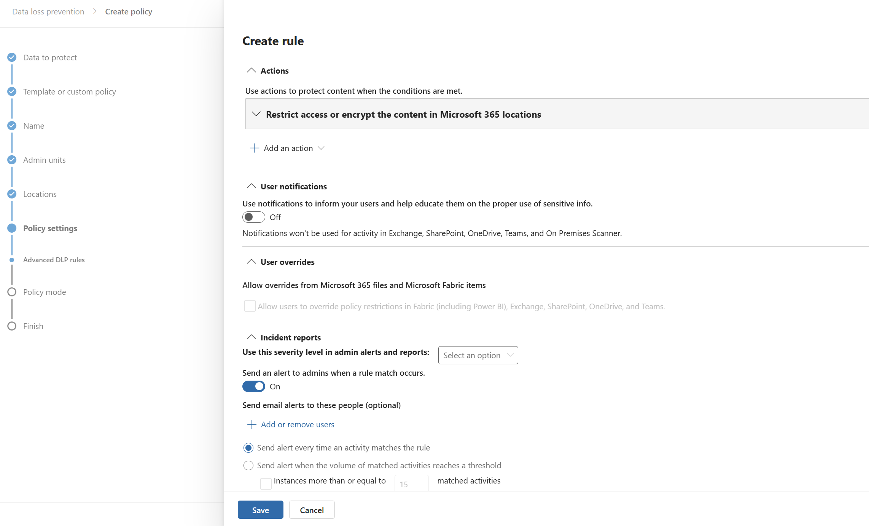

Apply DLP to email with custom SITs and label inheritance
Block the sharing of sensitive information
DLP can detect sensitive information in emails and attachments, block or restrict email messages, and enable email label inheritance so the email automatically adopts the most restrictive sensitivity label found on attached or linked files.
4
5
Available with IPG or above
How to do it
Go to purview.microsoft.com, Solutions > Data Loss Prevention
2) +Create policy > Data stored in connected sources
3) Choose template: Custom policy and name policy
6
7
4) Choose Exchange mail as location. Best practice is to have Email be it’s own DLP policy/workload
5) Choose conditions: Content is shared from M365 and then select detects ‘with people outside my org’
6) Choose conditions: Content contains and then add sensitivity labels All Employees
7) Under actions, Select Restrict Access or encrypt the content in M365 locations
8) Select Run the policy in simulation mode and click ‘Turn the policy on if it’s not edited within 15 days
Learn more on our “Create and deploy a data loss prevention policy | Microsoft Learn” page

Slide 17
Best
Protect your sensitive information
Block the sharing of sensitive information
Detect risky activities
Create sensitivity labels
Create sensitivity sub-labels
Publish sensitivity labels
Set as default label
Enable OneDrive and SharePoint labels
Enable Audit logging
Create custom sensitive info types (SITs)
Configure client-side auto-labeling
Add encryption to files
Extend service-side auto-labeling
Create and deploy DLP policies across:
Exchange
SharePoint
OneDrive
Teams
Endpoints
Apply email protection
Enable Insider Risk ‘Data Leaks’ policy
Enable Adaptive Protection for dynamic DLP policies
Enable Adaptive Protection for dynamic Conditional Access policies

Slide 18






Protect your sensitive information
Apply encryption to labeled content
Sensitivity labels can automatically apply encryption to files that are labeled or match custom SITs. This ensures only authorized users can access the content – even if it’s shared externally.
1
2
3
Available with IPG or above
How to do it
Go to purview.microsoft.com
Go to Solutions > Information protection
4
4
Select Sensitivity labels > Choose high-sensitivity sub-labels > Edit label
Under items, select control access:
Choose Assign permissions now
Set expiration, offline access
Assign permissions to users or groups
6) Save label
Learn more on our “Apply encryption using sensitivity labels | Microsoft Learn” page

Slide 19








Protect your sensitive information
Extend auto-labeling to M365 services
Service-side auto-labeling ensures that existing files in SharePoint and OneDrive, as well as emails in transit through Exchange, are automatically labeled based on content.
2
3
Available with IPG or above
How to do it
Go to purview.microsoft.com > Solutions > Information protection
2) Select Policy > Auto-labeling policy > Create auto-labeling policy
4
5
3) Name policy and choose Label to auto-apply
Choose locations: Exchange, SharePoint, OneDrive
5) Define conditions:
Content contains: add custom SITs
6) Choose policy mode: Run policy in simulation mode and automatically apply after 7 day period
7) Review and create policy
Learn more on our “Automatically apply a sensitivity label to Microsoft 365 data | Microsoft Learn” page

Slide 20







Detect risky activities
Run Insider Risk Management Analytics to identify top risks
Leverage IRM Analytics to detect risky user activities – such as data leaks, exfiltration, or policy violations – and receive recommendations using built-in templates to address these risks.
1
2
Available with E5C or above
How to do it
Go to purview.microsoft.com> Solutions > Insider Risk Management
2) Under Overview > Turn on analytics to scan for potential risks> ‘Turn on Analytics’
3
4
5
3) Review results and click View details to get recommended policies based on your top risks.
4) Name your policy and define:
Users or groups to monitor
If needed, customize triggers (e.g. DLP alerts, labels changes, file downloads)
5) Click Create policy
Learn more on our “Learn about Insider Risk Management policy templates | Microsoft Learn” page

Slide 21








Detect risky activities
Enable Adaptive Protection in DLP policies to dynamically protect data
Create adaptive DLP policies to help balance data security with user productivity, by allowing low risk users to take certain actions while blocking high risk users from doing so.
1
2
Available with E5C or above
How to do it
Go to purview.microsoft.com> Solutions > Insider Risk Management
Select Adaptive Protection > Adaptive Protection settings and toggle On
3
2
3) Under Insider risk levels, Select associated Insider risk policy and adjust pre-configured thresholds for Minor, Moderate, Elevated risk to align with your risk tolerance
4) Now go to Solutions > Data Loss Prevention and edit a policy that you want to turn dynamic
5) Under Policy settings > Create rule > Add condition > select Insider risk level for Adaptive Protection is and select Elevated risk level
6) Edit Actions to Block file activities for elevated risk users
Learn more on our Learn about Adaptive Protection in data loss prevention | Microsoft Learn” page

Slide 22








Detect risky activities
Enable Adaptive Protection for dynamic Conditional Access policy
Create adaptive policies so that when a user is flagged as high risk, Conditional Access policies can dynamically restrict access to sensitive SharePoint sites and OneDrive content.
2
3
4
Available with E5C or above
How to do it
Go to purview.microsoft.com> Solutions > Insider Risk Management
Go to Adaptive Protection > and select Conditional Access
5
6
7
3) Select Create Policy which will redirect you to create a Conditional Access policy in Entra admin center
4) Select condition Insider risk > and Toggle On
5) Select Target resources> and select SharePoint and OneDrive
6) Under Access controls, select Block access
7) Enable policy and select Report-only or On and Save
Learn more on our Learn about Adaptive Protection in data loss prevention | Microsoft Learn” page

